Slide 1


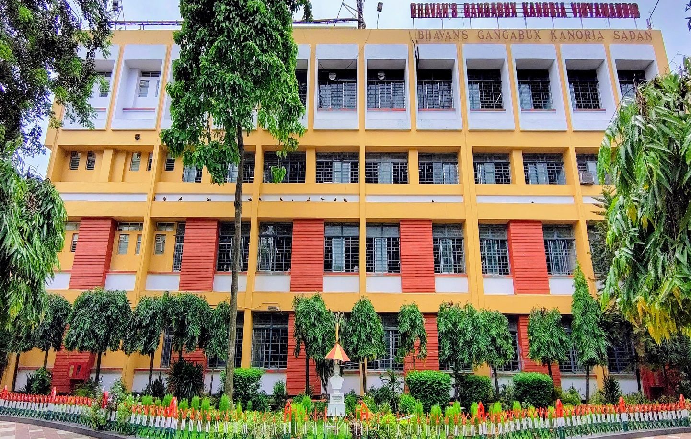
ANNUAL SCHOOL REPORT 2025

Slide 2
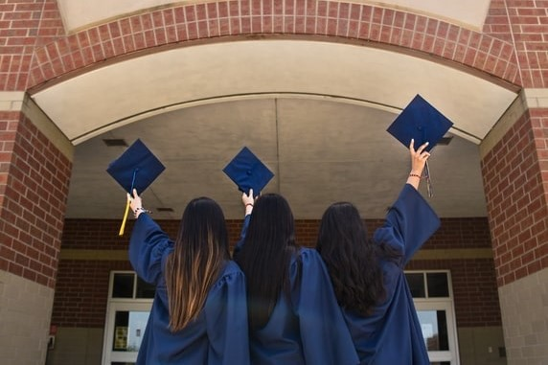
ACADEMIC ACHIEVEMENTS

Slide 3

AISSE(CLASS X)RESULTS-2025
Total No. of Students | Appeared | Qualified | 90% and Above | 80% and Above | 75% and Above (Distinction) | Average
Secondary Level Examination (AISSE) (Class X) | 260 | 260 (100%) | 152 (58.40%) | 219 (84.20%) | 233 (89.60%) | 88.30%

Slide 4
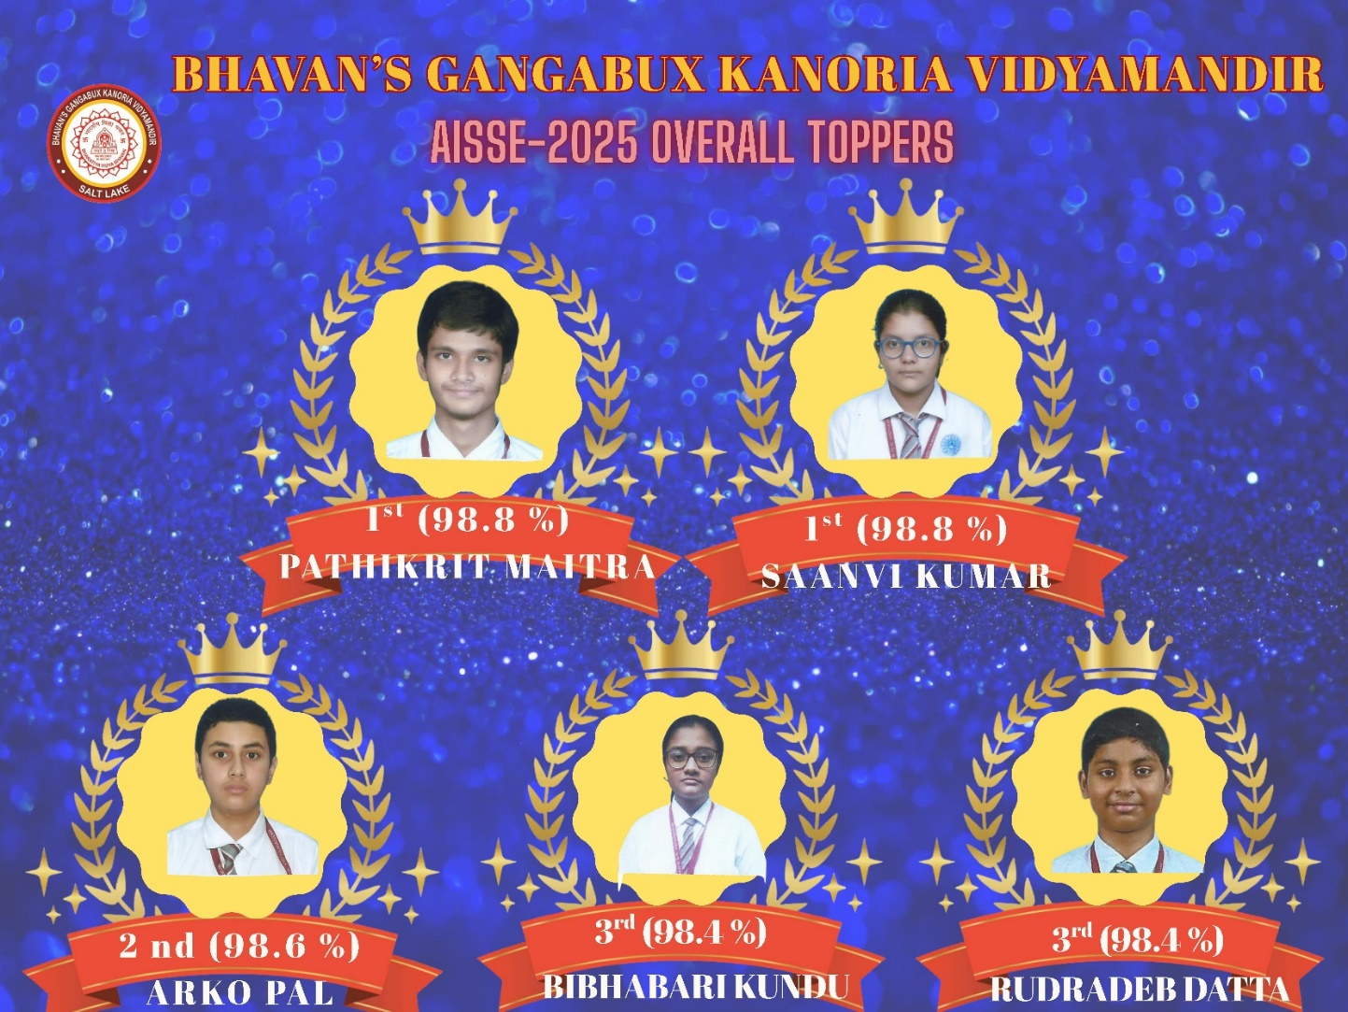

Slide 5
AISSCE(CLASS XII) RESULTS-2025
Total No. of Students | Appeared | Qualified | 90% and Above | 80% and Above | 75% and Above (Distinction) | Average
Senior Secondary Level Examination (AISSCE) (Class XII) | 250 | 250 (100%) | 100 (40%) | 96 (78.40%) | 225 (90%) | 86.41%

Slide 6
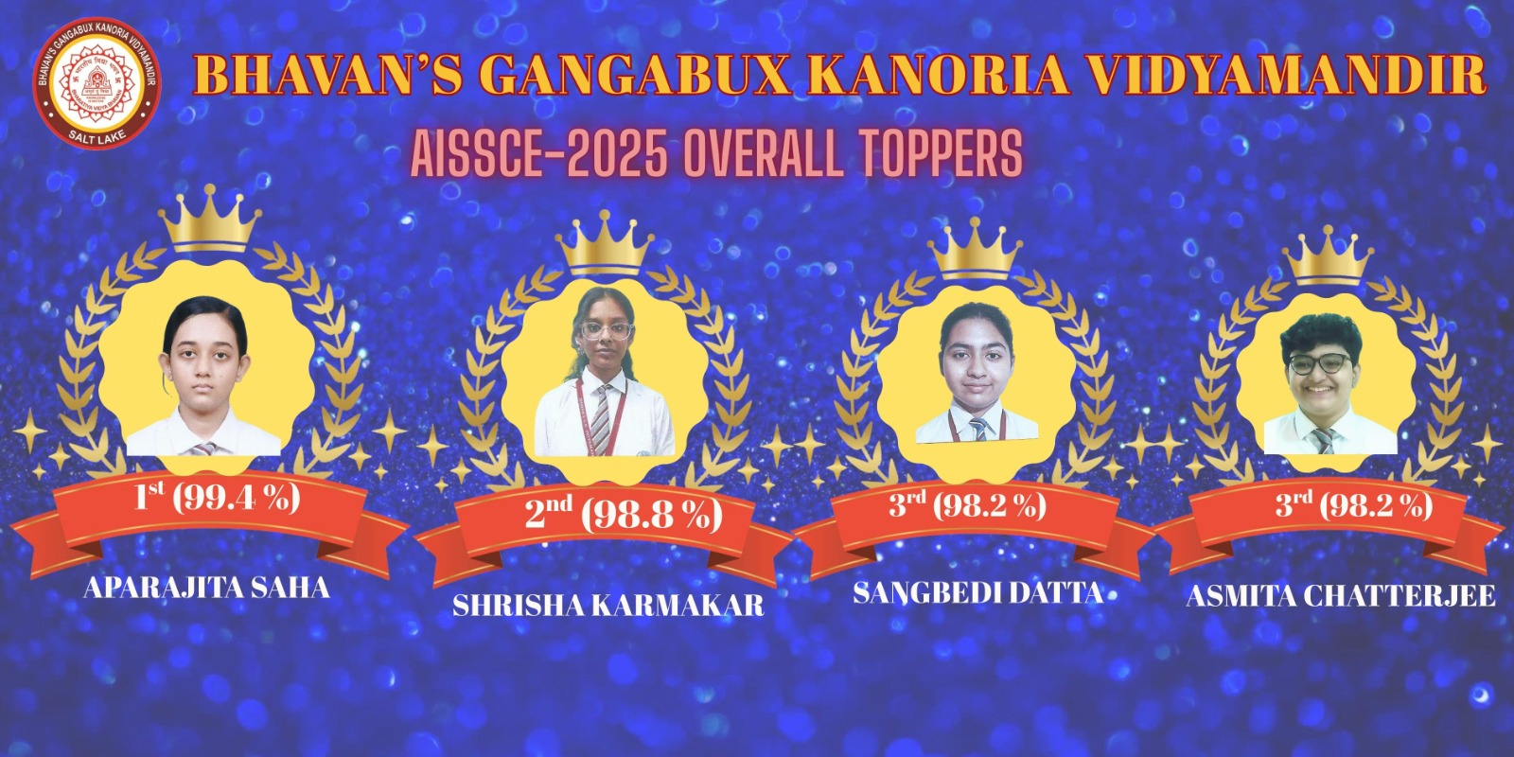

Slide 7
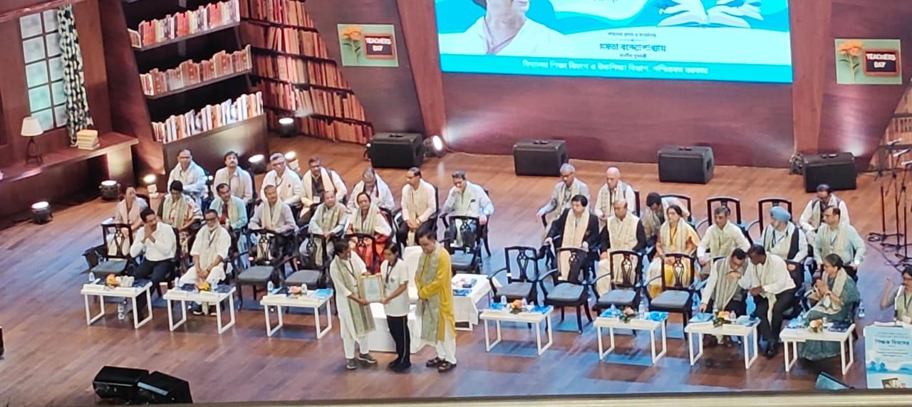
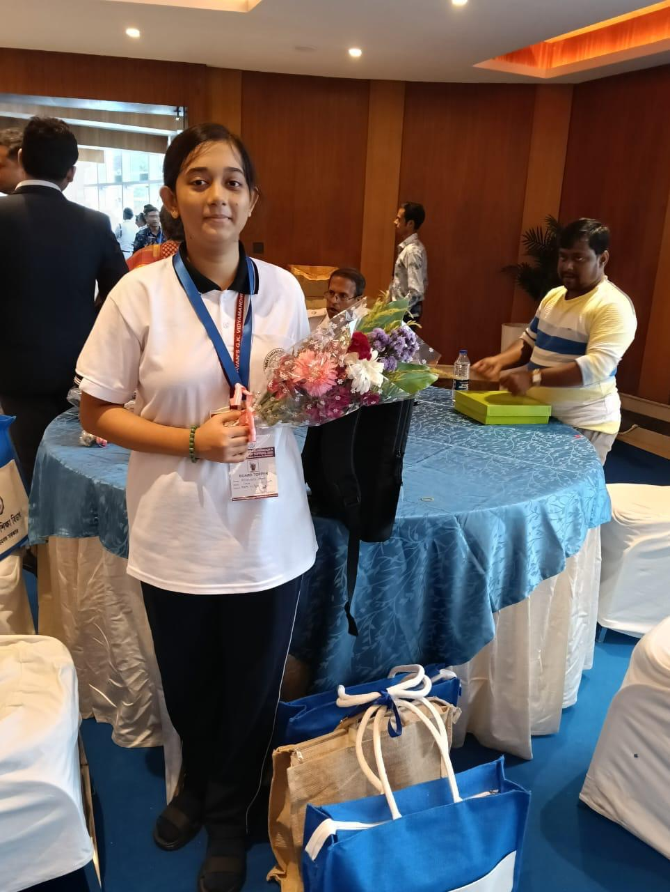
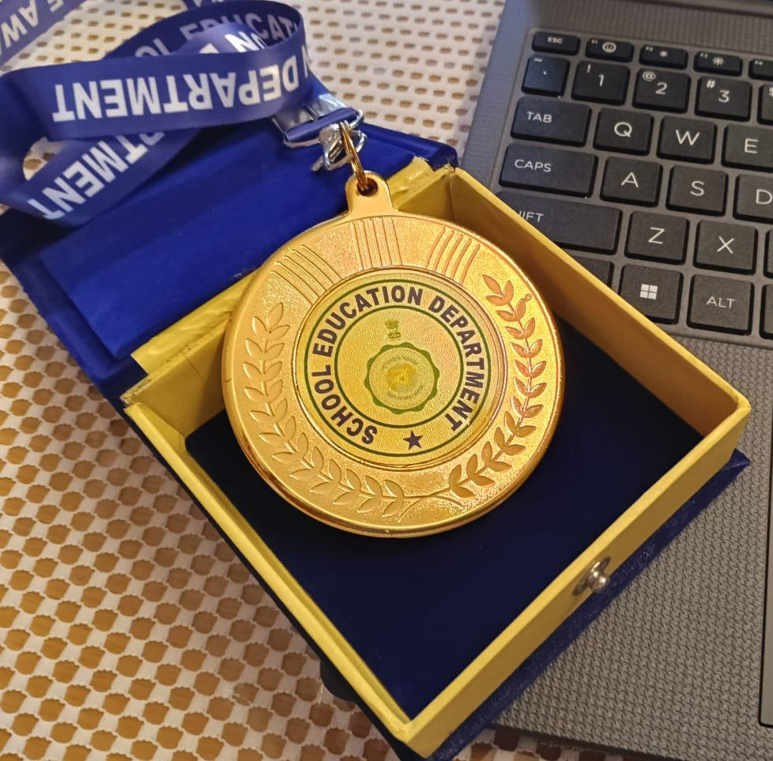
APARAJITA SAHA, OUR BOARD TOPPER, HAS BEEN DECLARED FIRST IN ALL-OVER BENGAL AND THIRD IN ALL-OVER INDIA IN CBSE CLASS XII EXAMINATION AND HAS BEEN FELICITATED BY THE GOVERNMENT OF WEST BENGAL.

Slide 8
STREAMWISE ANALYSIS - 2025

Slide 9
SCIENCE
NO. OF STUDENTS APPEARED | 147
DISTINCTION (ABOVE 75%) | 135 (91.83%)
ABOVE 90 % | 54
NAME | RANK | PERCENTAGE
ASMITA CHATTERJEE | 1ST | 98.2
AARYA CHAKRABARTY | 2ND | 97.6
ARCHITA RUDRA | 3RD | 97

Slide 10
COMMERCE
NO. OF STUDENTS APPEARED | 47
DISTINCTION (ABOVE 75%) | 38 (80.85%)
ABOVE 90 % | 13
NAME | RANK | PERCENTAGE
LAKSHYA BANSAL | 1ST | 96
RISHI SARAF SAURODEEP DEBNATH | 2ND | 95.8
HIMANSHU JALAN | 3RD | 95.2

Slide 11
HUMANITIES
NO. OF STUDENTS APPEARED | 56
DISTINCTION (ABOVE 75%) | 51 (91.83%)
ABOVE 90 % | 33
NAME | RANK | PERCENTAGE
APARAJITA SAHA | 1ST | 99.4
SHRISHA KARMAKAR | 2ND | 98.8
SANGBEDI DATTA | 3RD | 98.2

Slide 12

COMPETITIVE EXAMINATION RESULTS

Slide 13
JEE MAINS SESSION I & II 2025 (90% AND ABOVE) PERCENTILE RESULT
BHAVAN'S GANGABUX KANORIA VIDYAMANDIR
SL NO. | STUDENT NAME | CLASS & SECTION | PERCENTILE
1 | RHITAM SADHUKHAN | XIIS3 | 99.56
2 | AISHEE LAHIRI | XIIS3 | 99.04
3 | JISHNU RAY CHAUDHURI | XIIS3 | 98.91
4 | ARITRA CHAKRAVARTY | XIIS1 | 98.34
5 | AARYA CHAKRABARTY | XIIS4 | 98.33
6 | BHASWAR SUR | XIIS4 | 98.01
7 | BHARGAV MAITI | XIIS1 | 97.88
8 | DEBJIT DUTTA | XIIS1 | 97.86
9 | SHREYA BHAR | XIIS2 | 97.83
10 | OISHANI DAS | XIIS2 | 97.77
11 | ISHAN GHOSH DASTIDER | XIIS4 | 97.44
12 | ARKADEEP SEN | XIIS3 | 97.42
13 | SOHAM DUTTA | XIIS4 | 97.38
14 | ISHANI PAUL | XIIS3 | 96.54
15 | SWAPNIL CHATTERJEE | XIIS3 | 96.24
16 | ARKA KIRAN KHAN | XIIS2 | 96.21
17 | ASMITA CHATTERJEE | XIIS2 | 96.02
18 | AAHEL PAUL | XIIS1 | 95.82
19 | PRERONA PAUL | XIIS2 | 95.22
20 | SANKHADEEP BERA | XIIS3 | 94.89
21 | HIYA BHATTACHARYA | XIIS1 | 94.83
22 | SHREYA CHAKRABORTY | XIIS2 | 94.38
23 | BRATATI SARKER | XIIS2 | 94.37
24 | UTKARSH VARDHAN GARODIA | XIIS3 | 93.89
25 | ABHIGYAN PAL | XIIS4 | 93.87
26 | SOBUJ SANKAR KOLE | XIIS2 | 92.97
27 | TIRTHARAJ MULLICK | XIIS1 | 92.88

Slide 14
BHAVAN'S GANGABUX KANORIA VIDYAMANDIR
DIFFERENT COMPETITIVE EXAMINATION RESULT
BHAVAN'S GANGABUX KANORIA VIDYAMANDIR
NEET RESULT 2025
SL NO. | NAME | AIR RANK | CATEGORY RANK
1 | PRERONA PAUL | 4528 | 2266
2 | BHARGAV MAITI | 10755 | 4795
3 | DEBJIT DUTTA | 14426 | 6186
4 | OISHANI DAS | 21300 | 8675
5 | HIYA BHATTACHARYA | 24744 | 9890
6 | BRATATI SARKER | 25994 | 580
7 | AMLAN CHAKRABORTY | 34503 | 13297
8 | SOBUJ SANKAR KOLEY | 46166 | 17247
9 | HEMA VERMA | 64513 | 23272
10 | ASMITA CHATTERJEE | 119072 | 40707
NAME OF EXAMINATION | NAME OF QUALIFIED STUDENTS | RANK
KITEE | SOUMYADEEP MAHAPATRA | 487
ISI KOLKATA ( BSTAT) | JISHNU RAY CHAUDHURI | 47
 | RHITAM SADHUKHAN | 85
SRMJEEE | ARKADEEP SEN | 14053
IEMJEE | ARKADEEP SEN | 171
VITEEE | UTKARSH VARDHAN GARODIA | 4280
COMEDK | UTKARSH VARDHAN GARODIA | 6095
IISER | ARITRA CHAKRAVARTY | 659
 | OISHANI DAS | 668
 | HIYA BHATTACHARYA | 674
 | SAKHADEEP BERA | 3065
 | ARKA KIRAN KHAN | 3459
BHAVAN’S GANGABUX KANORIA VIDYAMANDIR
JEE ADVANCED RESULT 2025
SL.NO. | NAME | CLASS & SECTION | RANK
1 | RHITAM SADHUKHAN | XIIS3 | 6379
2 | AISHEE LAHIRI | XIIS3 | 9386
3 | BHARGAV MAITY | XIIS3 | 12336
4 | AMLAN CHAKRABORTY | XIIS1 | 12620
5 | SOHAM DUTTA | XIIS4 | 15202
6 | JISHNU RAY CHAUDHURI | XIIS3 | 15315
7 | ISHANI PAUL | XIIS3 | 16343
8 | ARITRA CHAKRAVARTY | XIIS1 | 16596
9 | BHASWAR SUR | XIIS4 | 16982

Slide 15
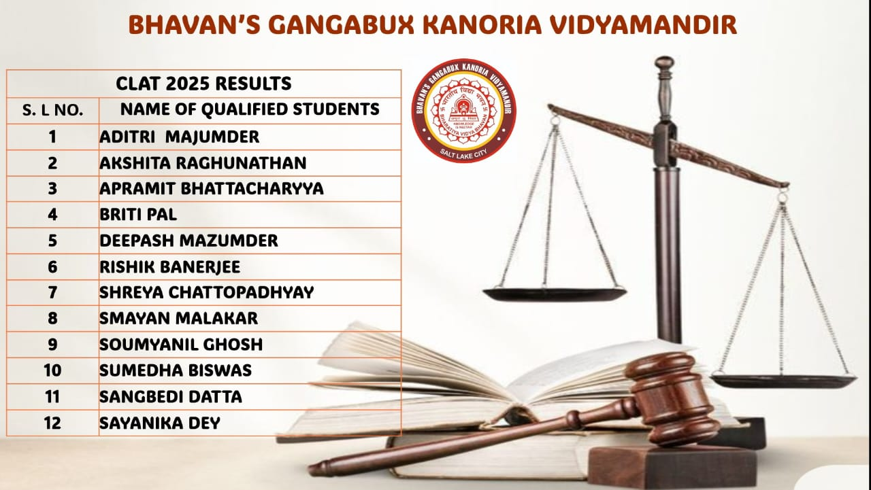
ClaT Result-2025

Slide 16
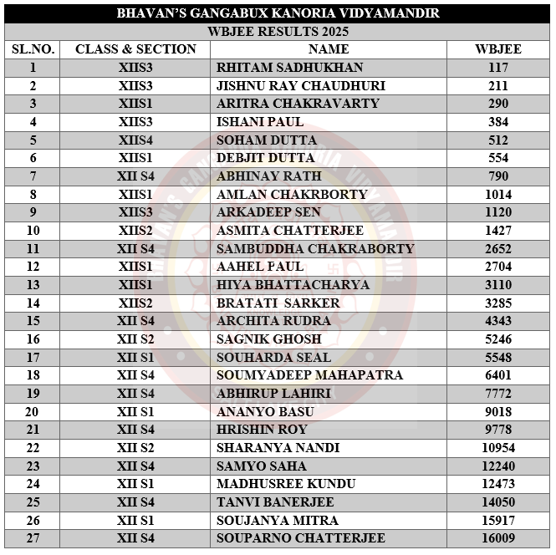
WBJEE Result 2025

Slide 17
VIDYARTHI VIGYAN MANTHAN 2025-26
LIST OF STUDENTS SELECTED FOR PARTICIPATION AT THE STATE LEVEL
CLASS | NAME OF STUDENTS’
6 | RUSHANK MITRA
 | SOUMYADEEP PAL
 | PUNNATOYA BASU
7 | SAMANWAY CHAKRABARTI
11 | SAMIKSHYA BEHERA

Slide 18
OLYMPIAD RESULTS:
In the National Science Olympiad 2024–2025, 39 students achieved a Zonal Rank within the top 200 in Level 1, and in Level 2, they ranked within the top 210.
In the International Mathematics Olympiad 2024–2025, 27 students secured positions within the top 220 Zonal Ranks in Level 1. In Level 2, 35 students achieved ranks within the top 290 at the Zonal level.
In the National Cyber Olympiad 2024–2025, 12 students secured positions within the top 380 at the International Level.
In the International Olympiad of English Language 2024–2025, 18 students secured ranks within the top 355 at the zonal level.

Slide 19
OLYMPIAD RESULTS:
In the International Social Studies Olympiad 2024–2025, 12 students secured ranks within the top 418 at the zonal level.
In the Smart Kids General Knowledge Olympiad 2024–2025, 7 students secured ranks within the top 557 at the zonal level.
In the TERI Green Olympiad, among 124 participants, 4 students have received Certificate of Distinction, and 82 students have received Certificate of Merit.

Slide 20

CO-SCHOLASTIC ACHIEVEMENTS

Slide 21

RECOGNITIONS BEYOND SCHOOL

Slide 22

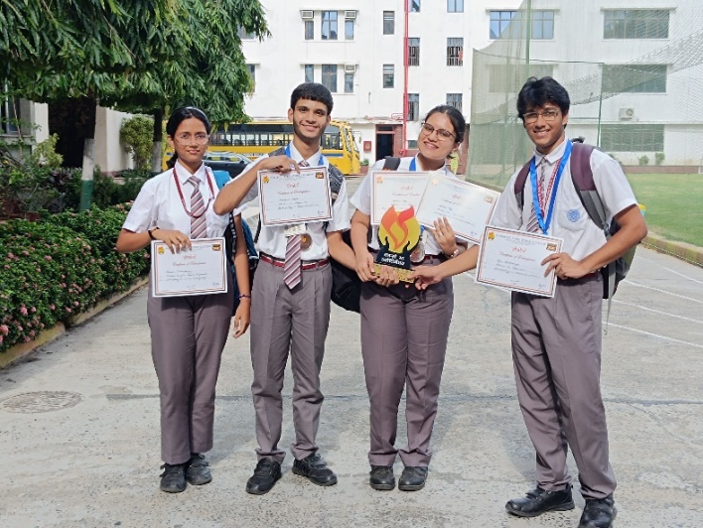
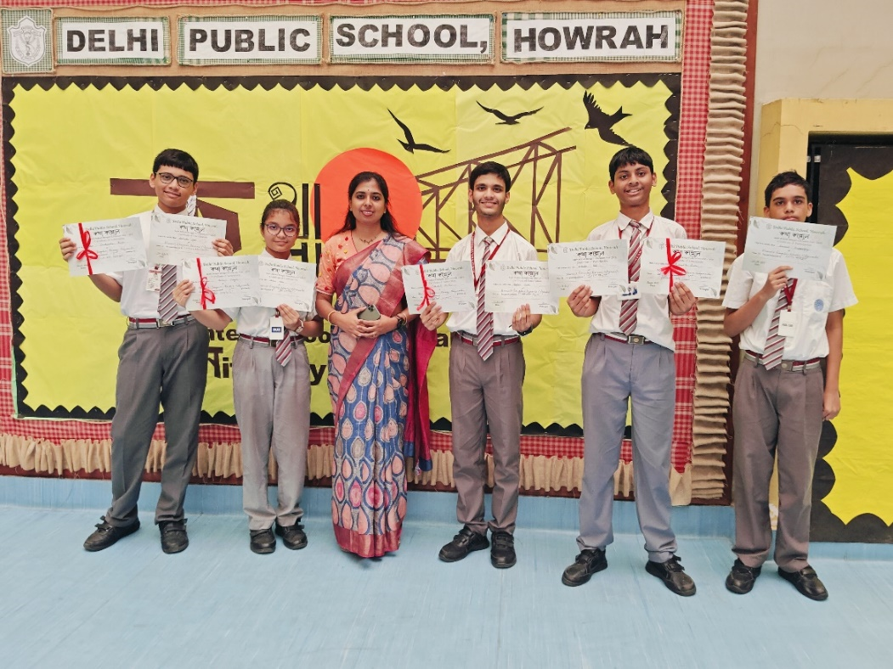
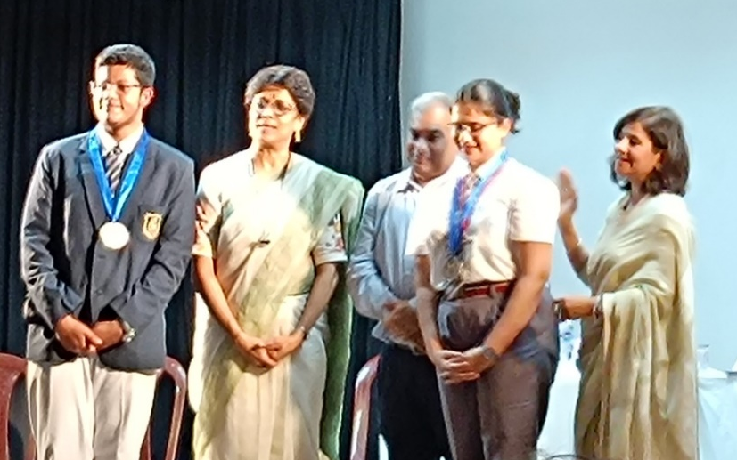
SHABD 2025, ORGANISED BY MAHADEVI BIRLA WORLD ACADEMY
23th – 25th June 2025
KATHA KALLOL 2025, ORGANISED BY DPS HOWRAH
24th June 2025
OUR ACHIEVERS:
OISHANI CHATTOPADHYAY,PATHIKRIT MAITRA, ADITREE RAY ,RYAN BHATTACHARJEE
AHANA HAZRA SECURED THE SECOND POSITION IN ‘বুলি ফোটাও’
RUDRADEB DATTA CAME THIRD IN ‘টুকটাক শব্দ থাক’
SANKARSHAN KUNDU WON SECOND PRIZE IN ‘গান নয়; এ-তো স্লোগান’.
PATHIKRIT MAITRA EARNED THE FIRST POSITION IN ‘তাৎক্ষণিক বক্তৃতা’.
ADITREE RAY SECURED THE FIRST POSITION IN EXTEMPORE AND DEBATE PARTICIPANTS SECURED THE THIRD POSITION.

Slide 23
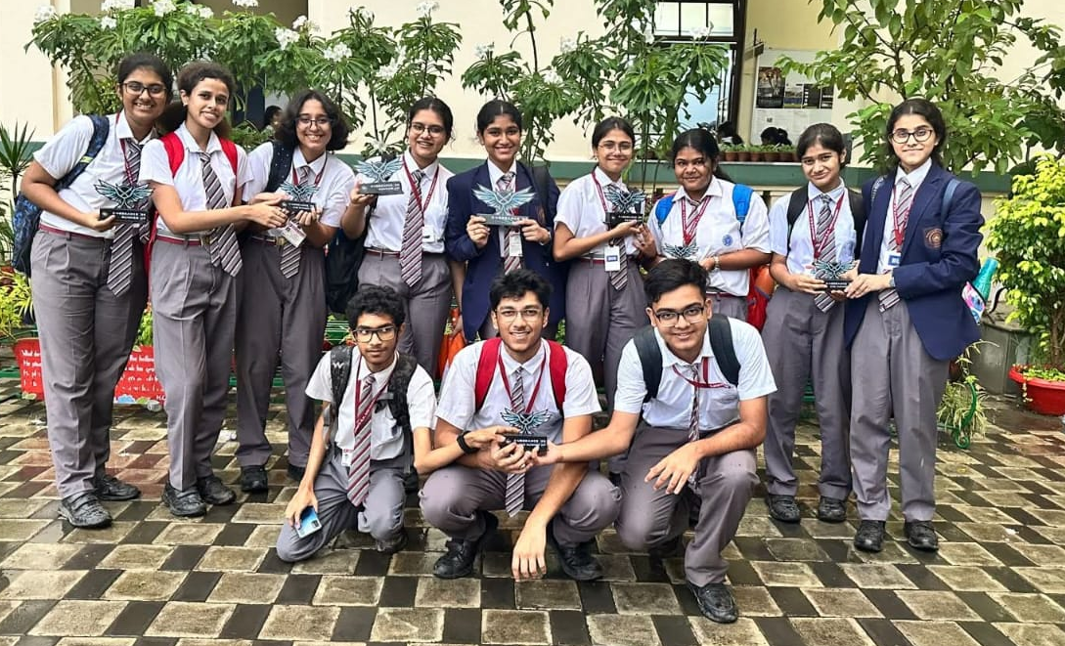
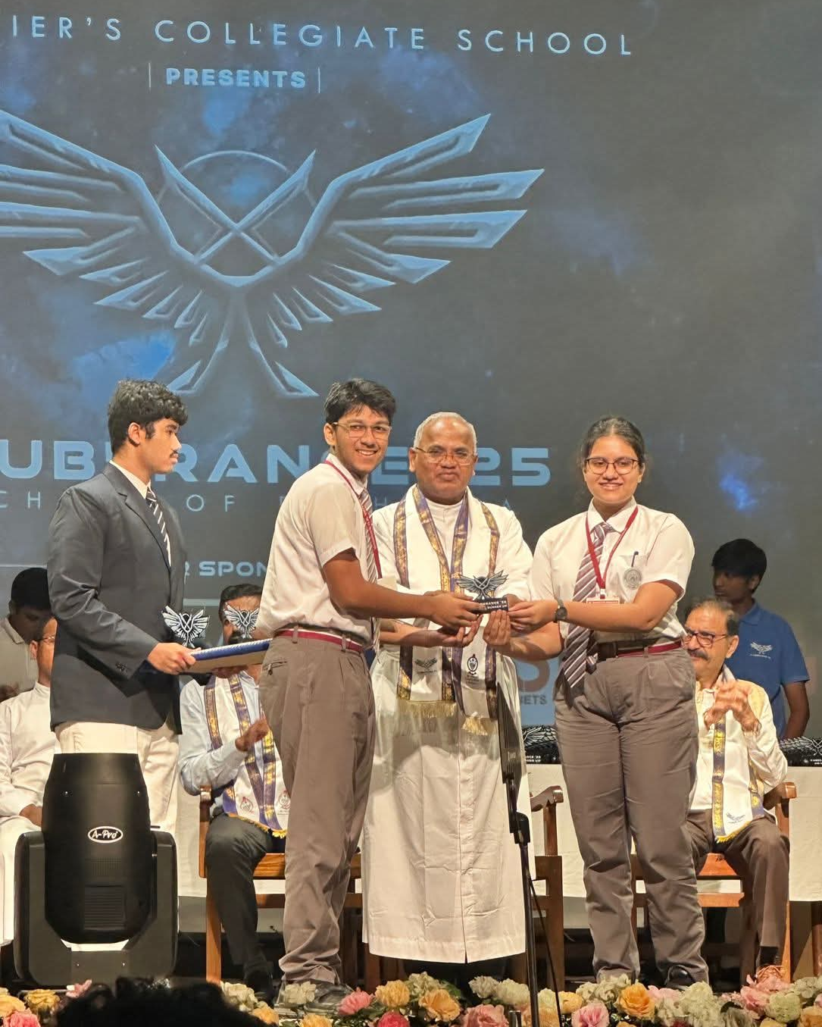
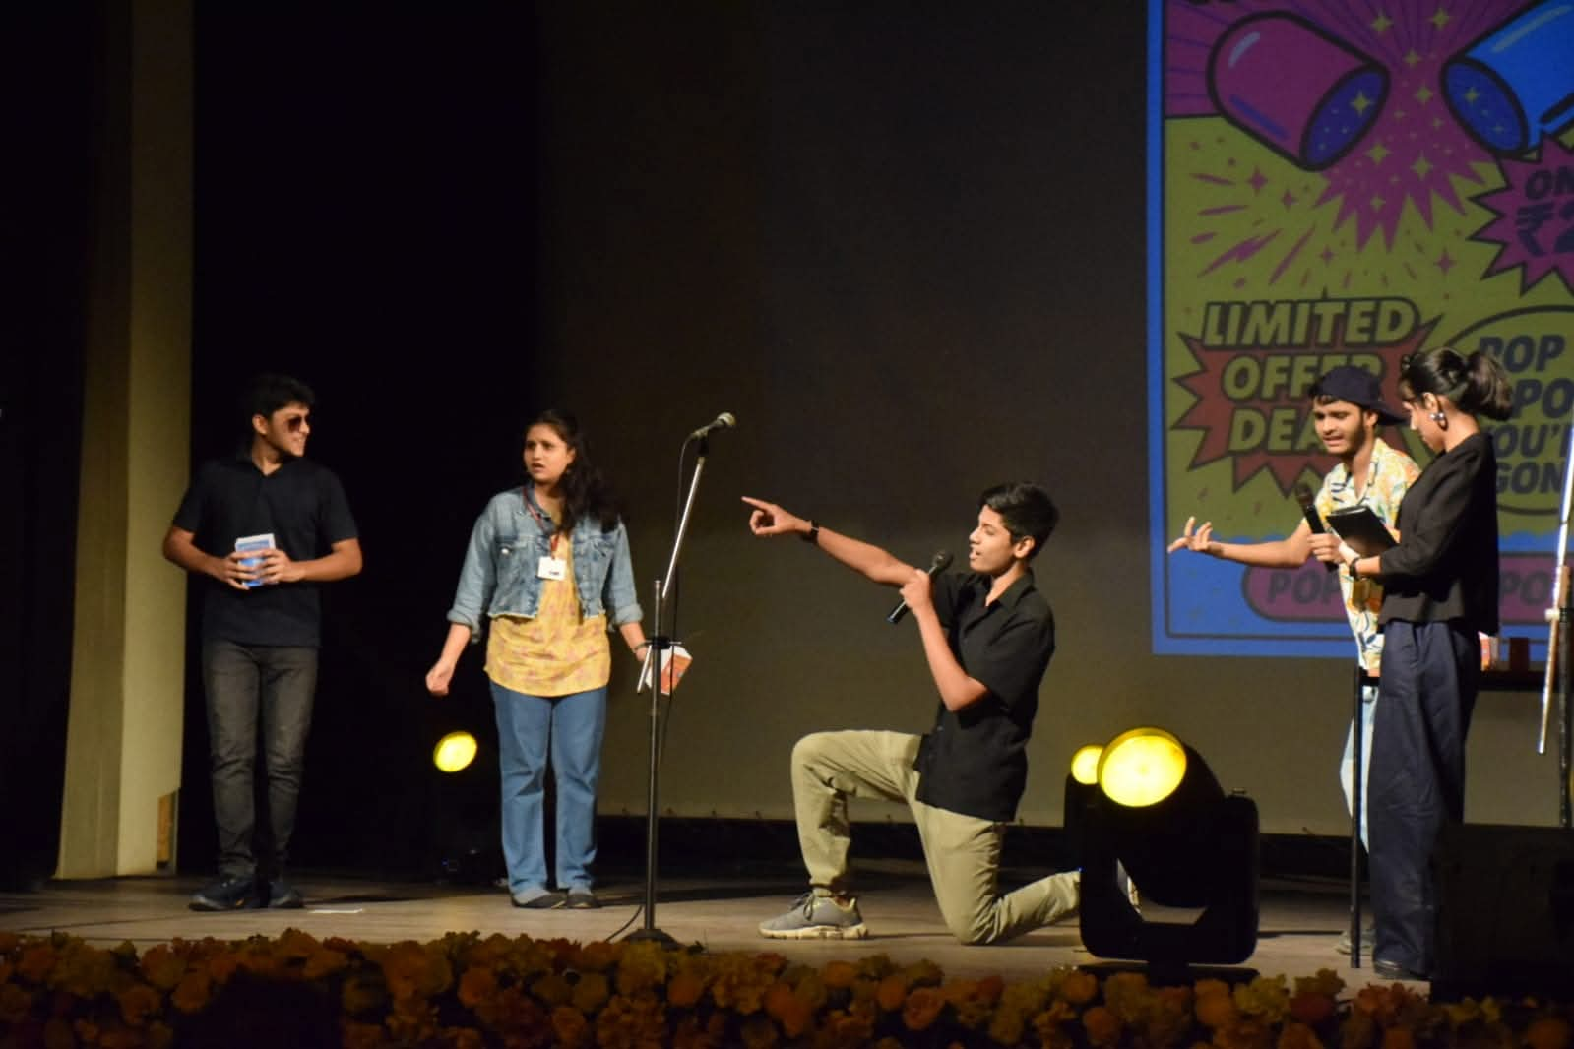
X-UBERANCE 2025,ORGANISED BY
ST. XAVIER’S COLLEGIATE SCHOOL
11th-13th July 2025
X ACT - FIRST
X SHRUTI - SECOND
X SCRIPT (HINDI) - SECOND
X GOLPO - SECOND
X KALA - THIRD
X TORKOBITORKO -THIRD
X PIXEL - THIRD
X - TEMPORE - THIRD
BHAVAN’S SECURED OVERALL THIRD POSITION.
OUR YOUNG AND TALENTED ACHIEVERS

Slide 24
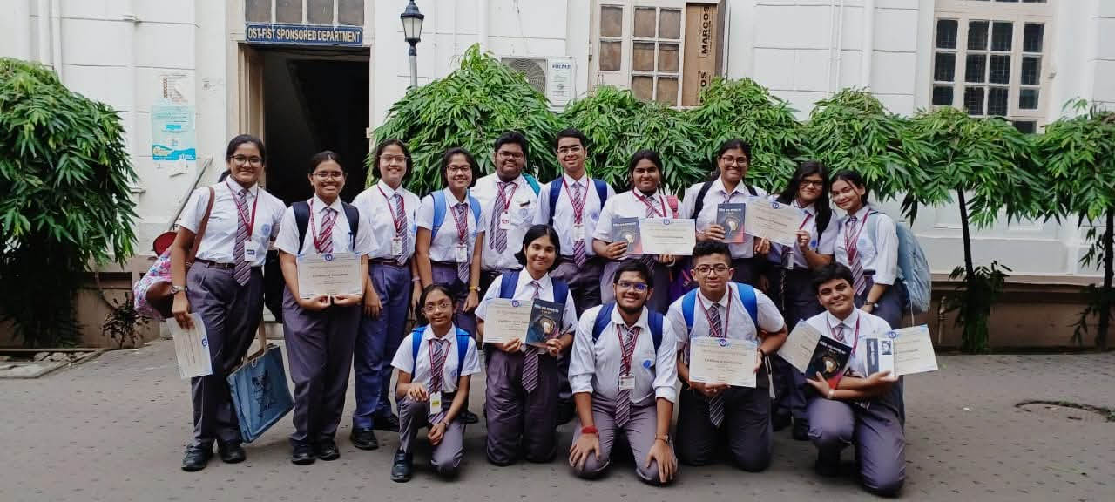
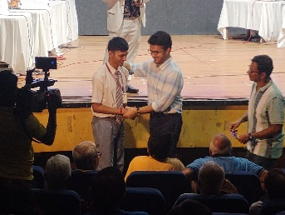
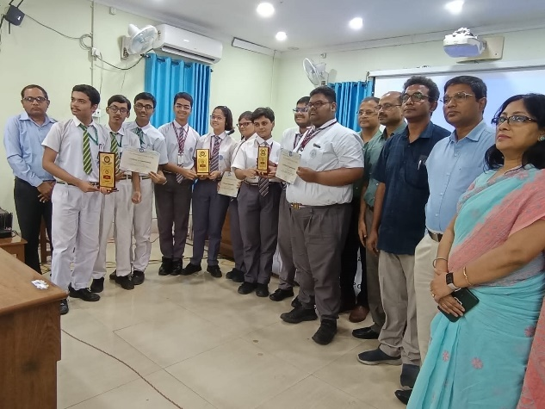
EXCELSIORS QUIZ 2025,ORGANISED BY
THE EXCELSIORS CLUB
13th July 2025
SIT & DRAW COMPETITION, ORGANISED BY
RAJABAZAR SCIENCE COLLEGE
12th July 2025
IN SIT AND DRAW COMPETITION, ANISHA GHOSH SECURED THE WINNER’S TITLE,
AKRITI PRASAD HELA – FIRST RUNNER-UP
ASMI HAZRA - SECOND RUNNER-UP.
SHRUTI ROY MITRA WAS DECLARED WINNER
SRAVASTI BASU - SECOND RUNNER-UP.
A SPECIAL JURY AWARD WAS CONFERRED ON DIDHITI DAS FOR HER OUTSTANDING PRESENTATION.
IN THE QUIZ COMPETITION NIRABHRA NANDI MANDAL, ANISHKA GHOSH, AND ATREYE MAITI EMERGED AS THE FIRST RUNNER-UP
AYANTAN MUKHOPADHYAY, SRAVASTI BASU, AND RAJDEEP DEBNATH BECAME THE SECOND RUNNER-UP.
OUR SCHOOL TEAM WON THE THIRD POSITION AND RECEIVED THE PRIZE FROM THE CHIEF GUEST SRI SOURAV GANGULY.
BGKV CONTINGENT

Slide 25
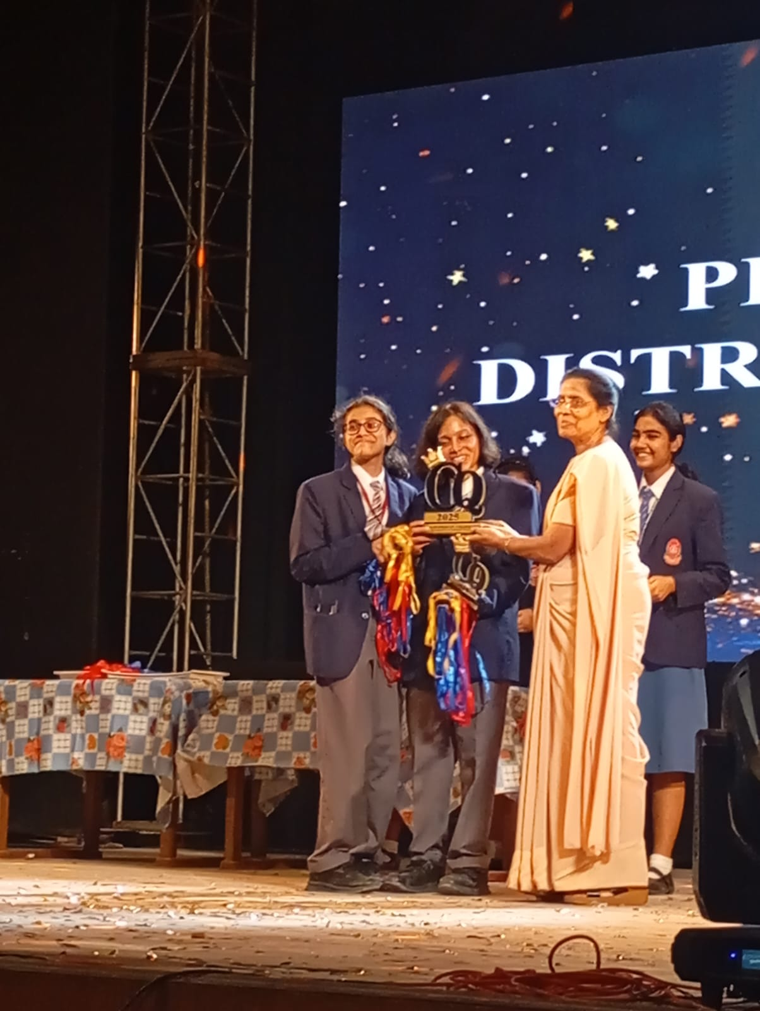
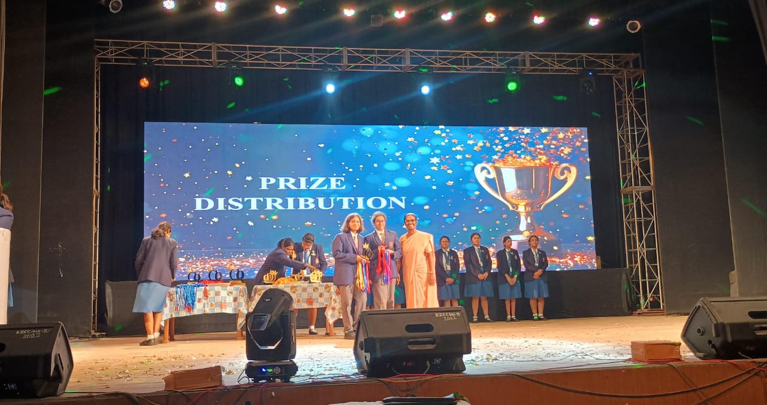
CHIAROS QURO,
ORGANISED BY QMS, SALT LAKE
25th & 26th July 2025
BHAVAN’S BAGGED PRIZES IN THE FOLLOWING EVENTS:
Q' RHETORIC (DEBATE): FIRST
Q' RUSH : FIRST
Q' SPELL: FIRST
Q' CLICK : FIRST
Q' ENACT: SECOND
Q' WIZ BIBLE QUIZ : THIRD
Q' CREATE: FIRST
Q' CHARISMA: FIRST
Q' DAZZLE: SECOND
Q' SYNC: THIRD
Q' JAZZ: SECOND
Q' CHRONICLE: THIRD
Q WIZ 1: THIRD
Q TWAIN: THIRD
Q DECLAMATION: FIRST
Q CHEF: FIRST
Q WIZ 2: THIRD
Q TALES ENGLISH : THIRD
Q TALES HINDI: FIRST
Q TALES BENGALI: FIRST
Q GRAFFITI: FIRST
Q SPELL: FIRST
OUR STUDENTS AT THE QMS,
PRIZE DISTRIBUTION CEREMONY
WINNER OF THE
SECOND BEST SCHOOL AWARD

Slide 26
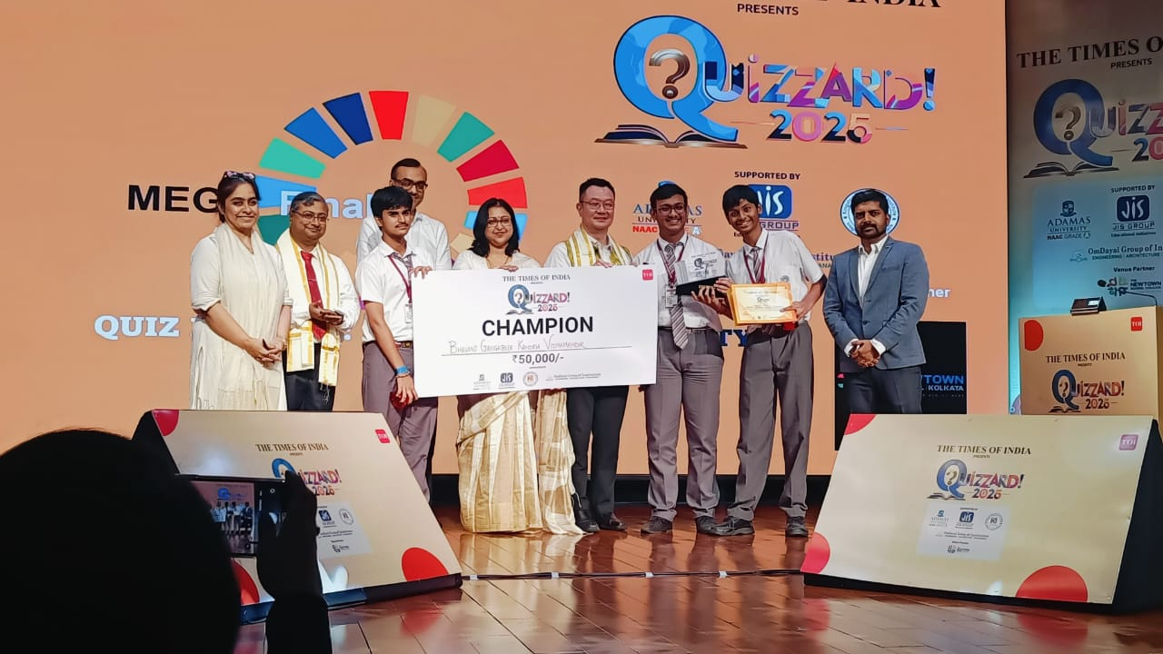
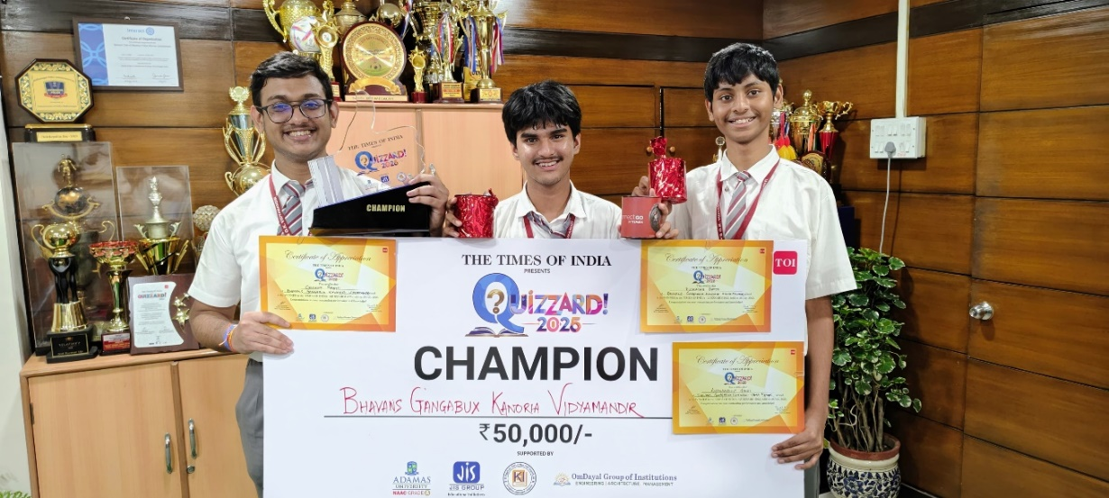
QUIZZARD 2025,ORGANISED BY THE TIMES OF INDIA
28th July 2025
DEMONSTRATING EXCEPTIONAL KNOWLEDGE AND TEAMWORK :
ANANDAROOP GHOSH
RUDRADEB DATTA, AND
ORIHANT BAGCHI
WINNER OF CASH PRIZE OF 50,000 /-.

Slide 27
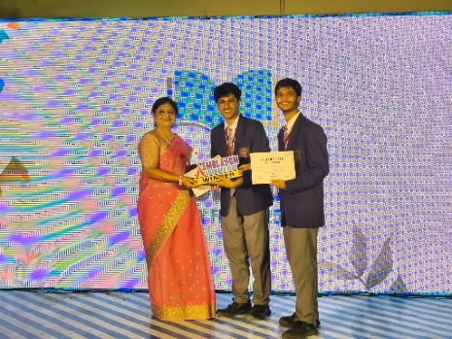
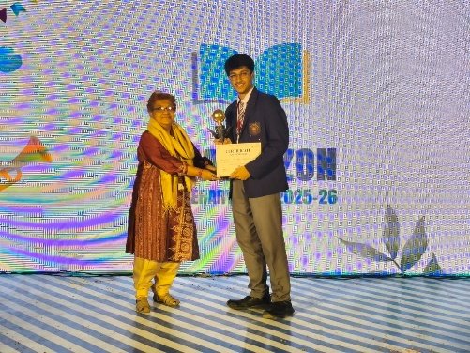
EMBLAZON, ORGANISED BY
ADITYA ACADEMY
7th August 2025
PATHIKRIT MAITRA AND RYAN BHATTACHARJEE EMERGED AS WINNERS IN THE DEBATE COMPETITION.
RYAN BHATTACHARJEE BEING HONOURED AS THE BEST SPEAKER OF THE EVENT.

Slide 28
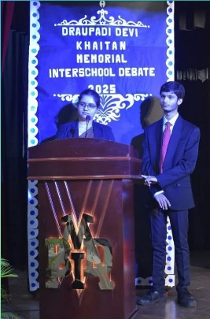
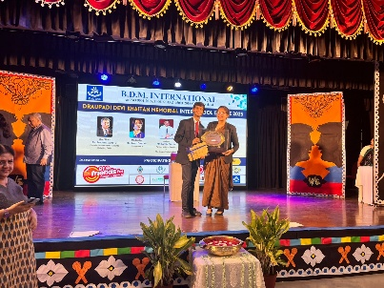
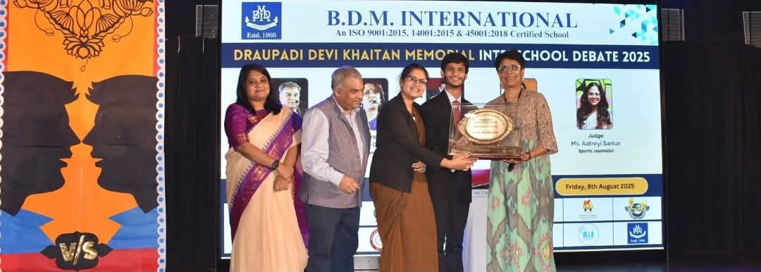
DRAUPADI DEVI KHAITAN MEMORIAL INTERSCHOOL DEBATE 2025,
ORGANISED BY
BDM INTERNATIONAL SCHOOL
8th August 2025
PATHIKRIT MAITRA AND ADITREE RAY
SECURED THE FIRST RUNNER-UP POSITION
AT THE DRAUPADI DEVI KHAITAN MEMORIAL INTER-SCHOOL DEBATE 2025.

Slide 29
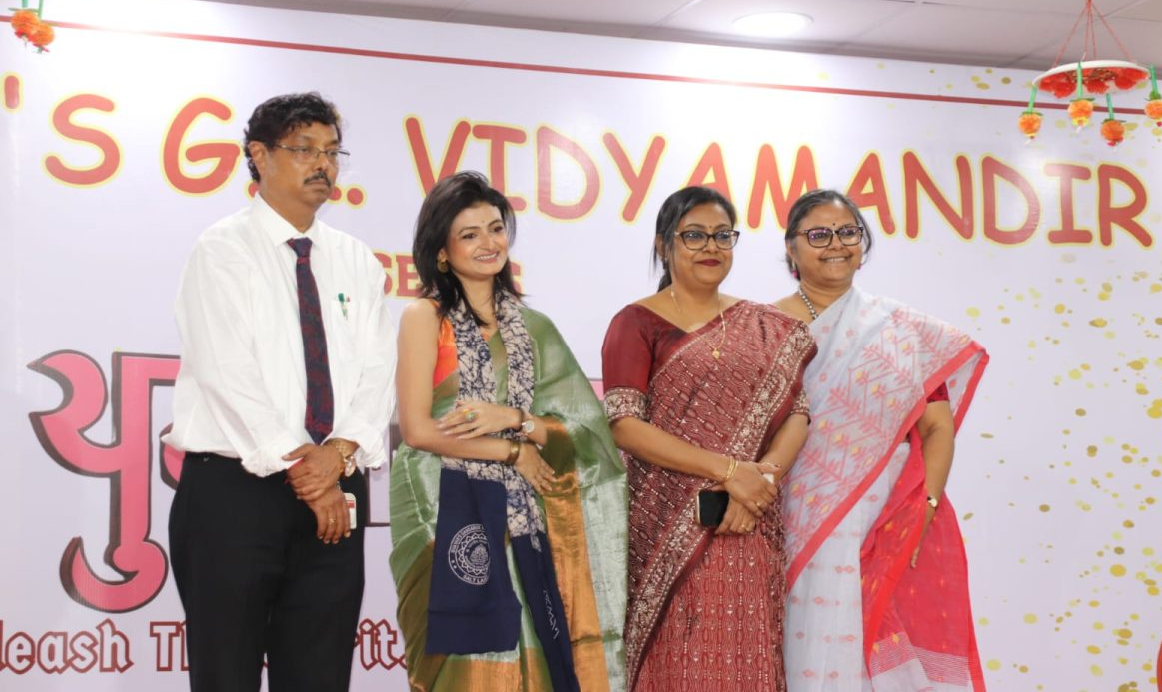
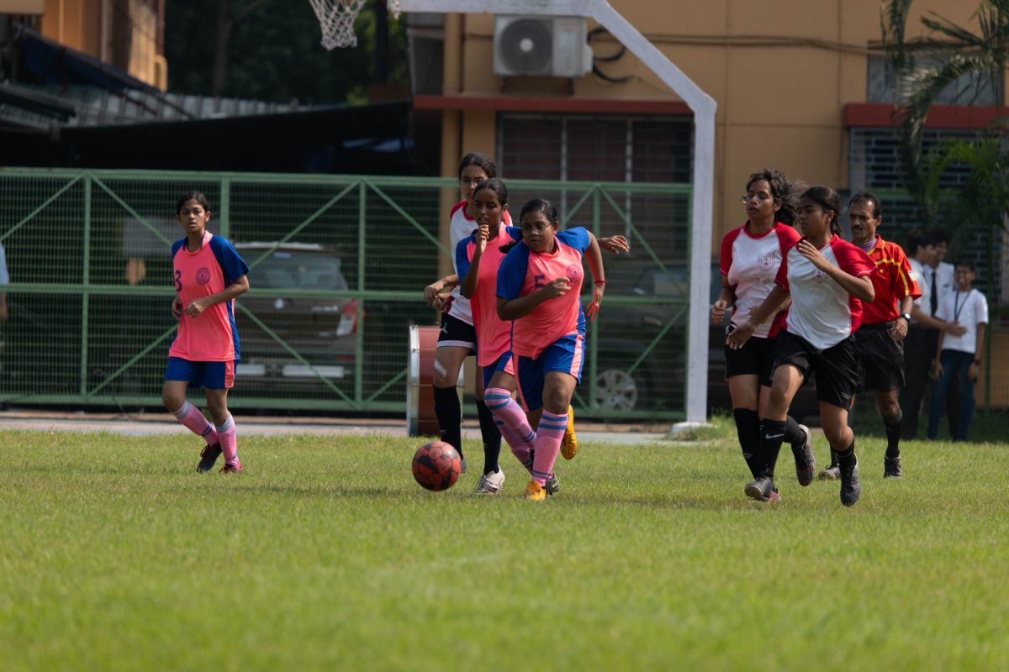
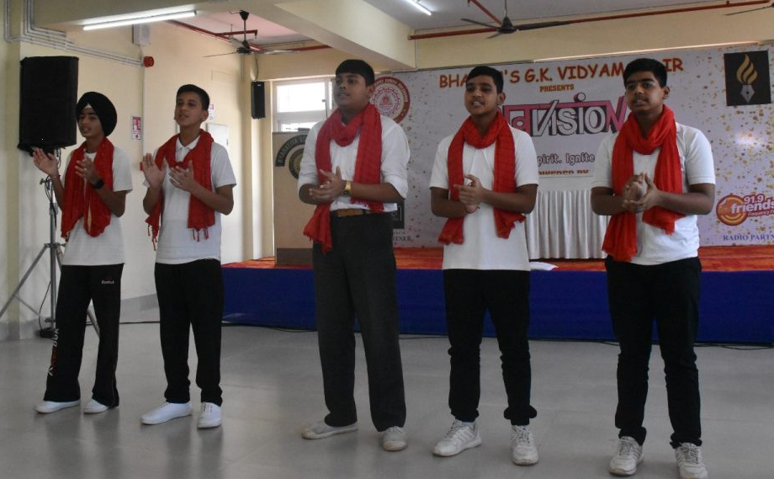
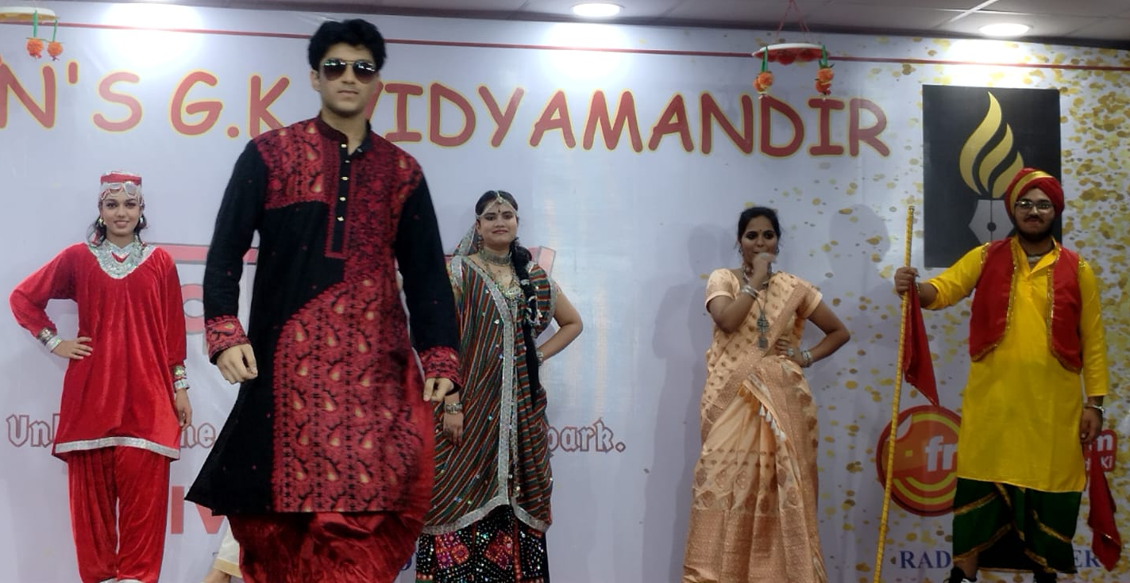
YUV-VISION - ANNUAL INTER-SCHOOL FEST
UNLEASH THE SPIRIT, IGNITE THE SPARK!
13th & 14th October 2025
OVER 25 REPUTED SCHOOLS FROM IN AND AROUND KOLKATA PARTICIPATED IN THIS GRAND CELEBRATION OF YOUTHFUL ENERGY AND CREATIVITY

Slide 30
HEI SUOMI QUIZ (FINLAND QUIZ ) 2025, ORGANISED BY
THE FINLAND EMBASSY
13th November 2025
SUSNATO BANERJEE AND SAPTAPARNO MAJUMDER RECEIVING ₹15000/- AS RUNNERS-UP PRIZE.

Slide 31
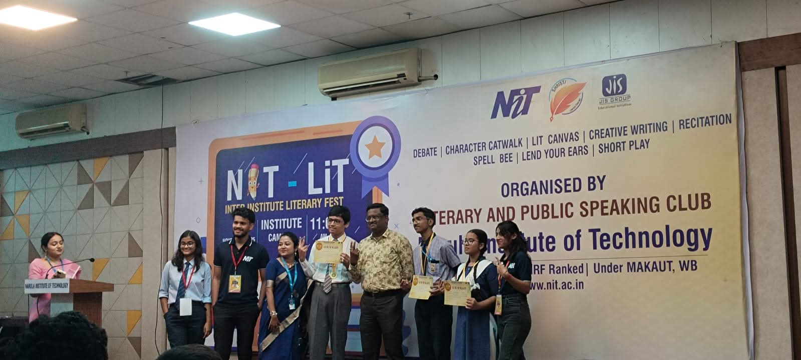
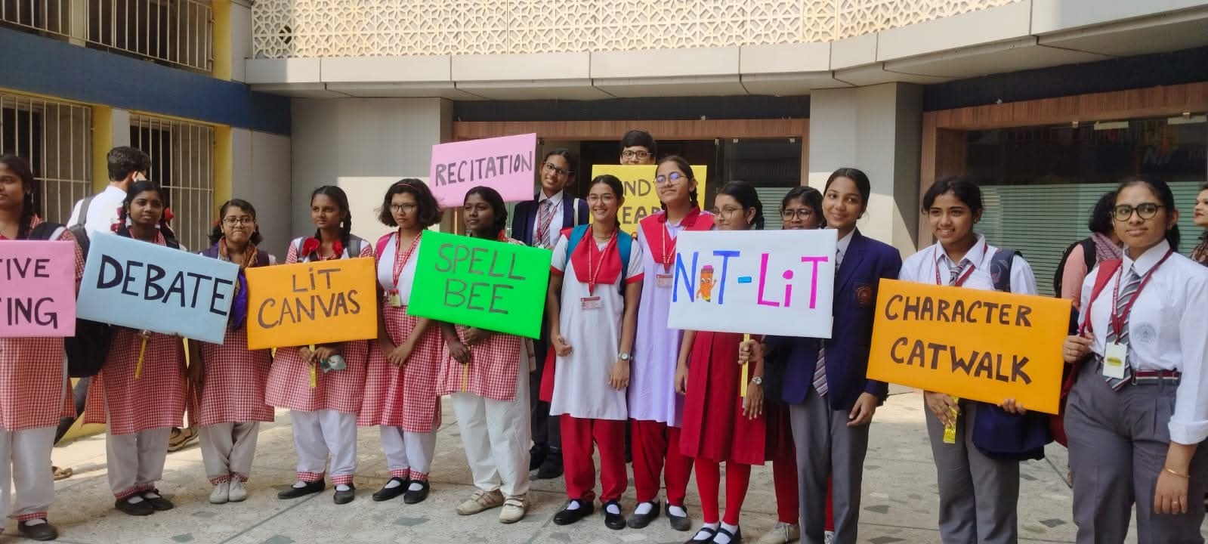
NIT-LIT 2025- INTER INSTITUTE LITERARY FEST, ORGANISED BY LITERARY AND PUBLIC SPEAKING CLUB OF NARULA INSTITUTE OF TECHNOLOGY
13th November 2025
SANKARSHAN KUNDU RECEIVING THE
FIRST POSITION IN ‘LEND YOUR EARS’.
OUR STUDENTS AMONG ALL THE OTHER PARTICIPANTS

Slide 32
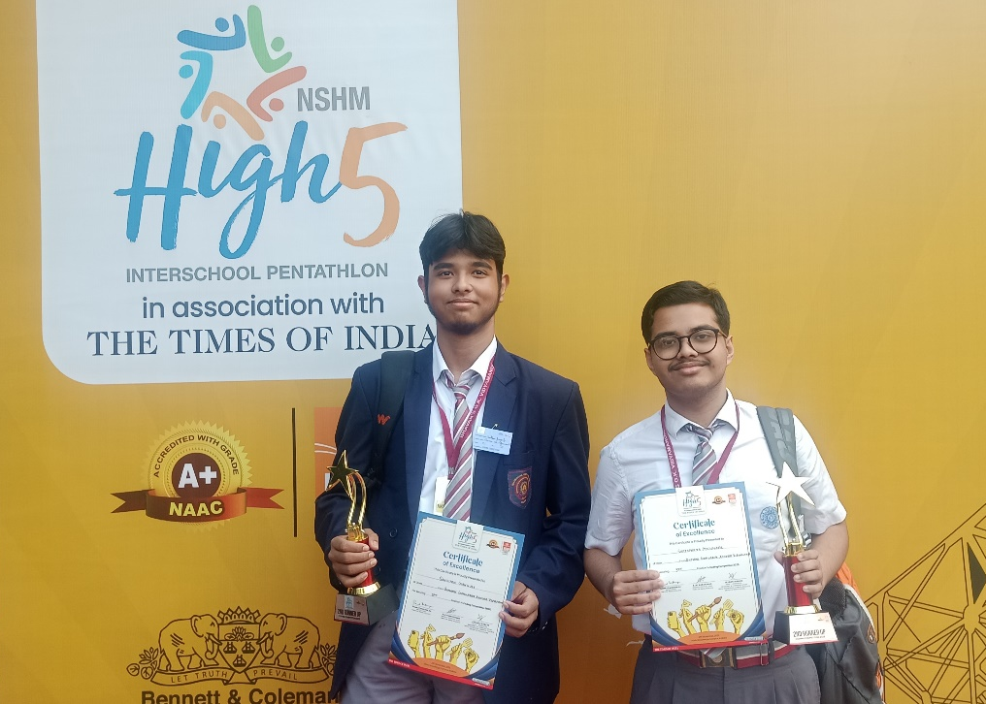
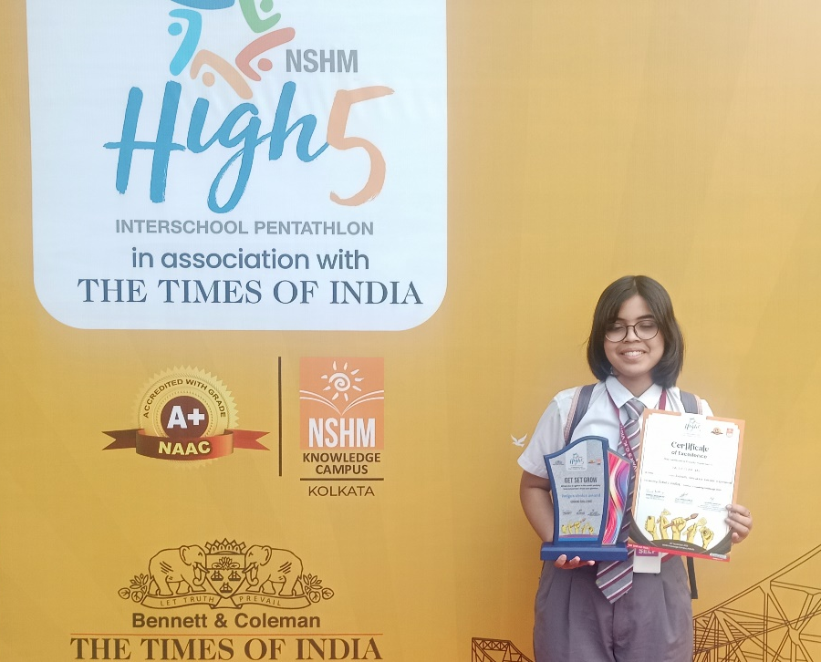
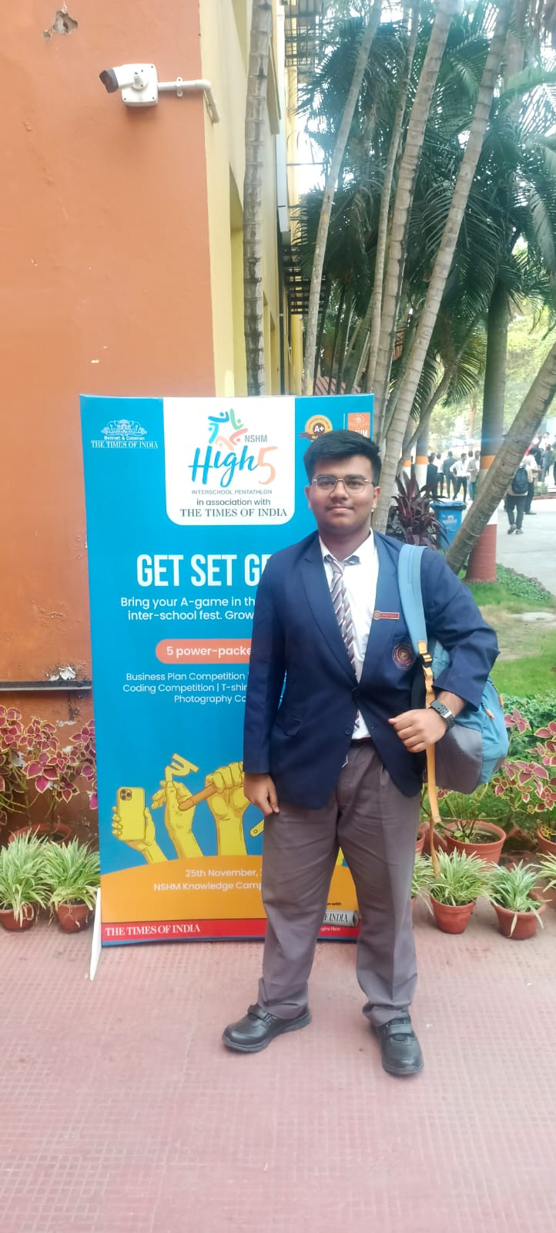
HIGH5 INTER SCHOOL PENTATHLON ORGANISED BY
THE TIMES OF INDIA
25th November 2025
SANDIPAN GANGULY AND SAPTAPARNO MAZUMDER BECAME SECOND RUNNERS UP IN
‘CODING’ COMPETITION
VALENTINA DAS RECEIVED ‘THE JUDGES CHOICE AWARD’ IN ‘THE NON FIRE COOKING’ COMPETITION.
MONIPUSPOK GHOSH WAS SELECTED AT THE TOP 10 LEVEL AMONG 75 SCHOOLS IN T-SHIRT PAINTING

Slide 33

AWARDS
&
ACCOLADES

Slide 34

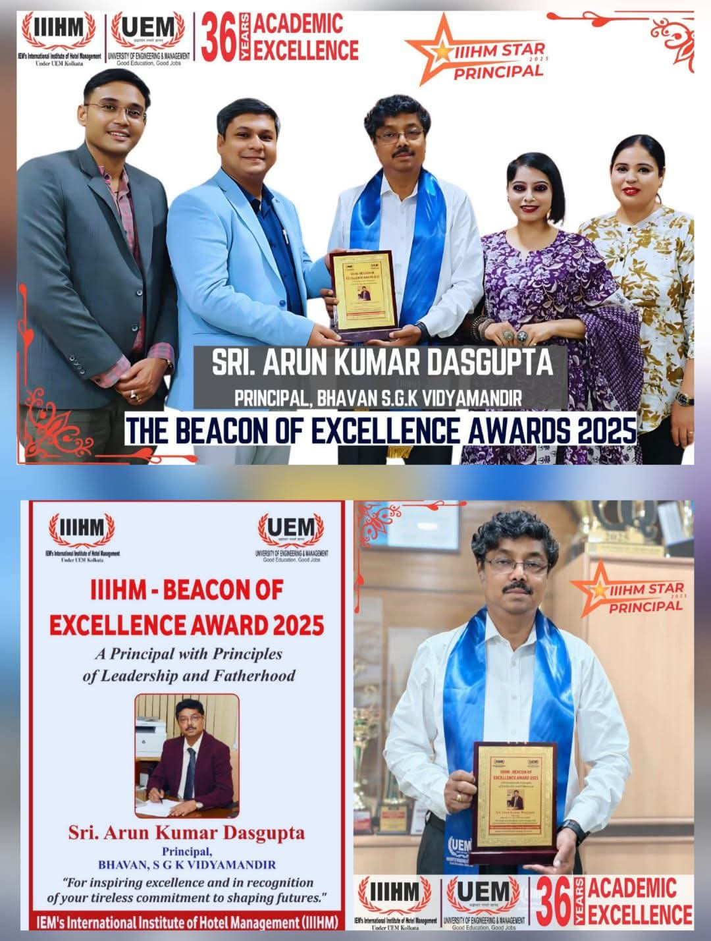
BEACON OF EXCELLENCE AWARD 2025
17th September 2025
THE PRINCIPAL,
SRI ARUN KUMAR DASGUPTA WAS FELICITATED WITH THE BEACON OF EXCELLENCE AWARD 2025 BY IIIHM, ‘Celebrated as an Institution himself – A Principal with Principles of Leadership and Fatherhood.’

Slide 35
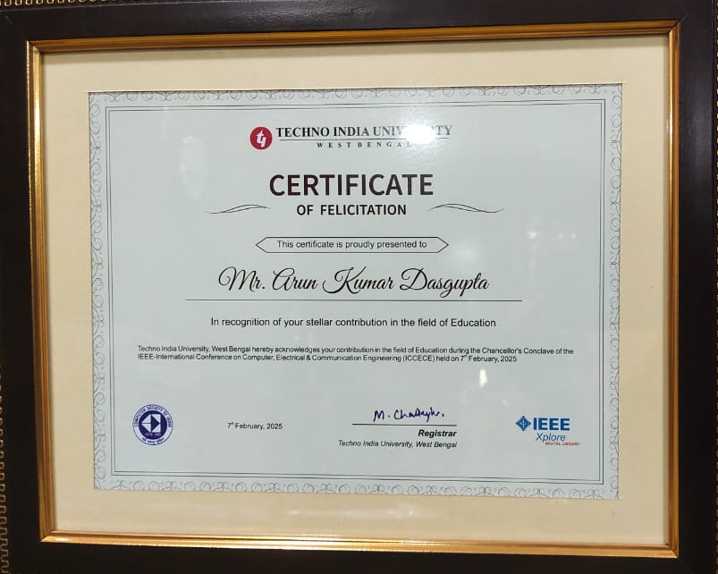
FELICITATION BY TECHNO INDIA UNIVERSITY
7th February 2025
THE PRINCIPAL WAS RECOGNISED FOR HIS
“STELLAR CONTRIBUTION TO THE FIELD OF EDUCATION”

Slide 36
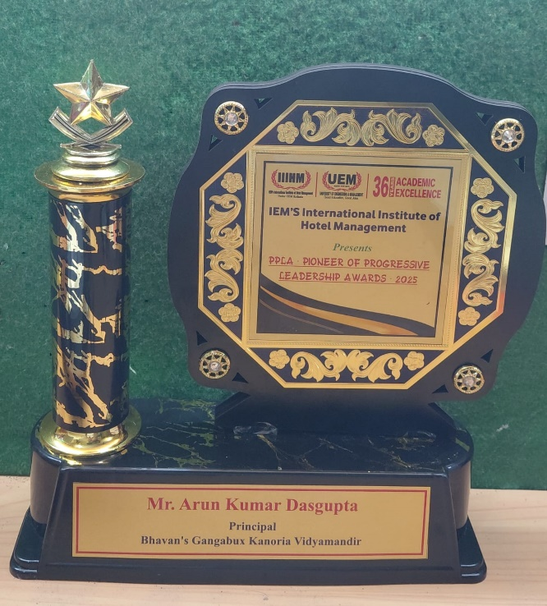
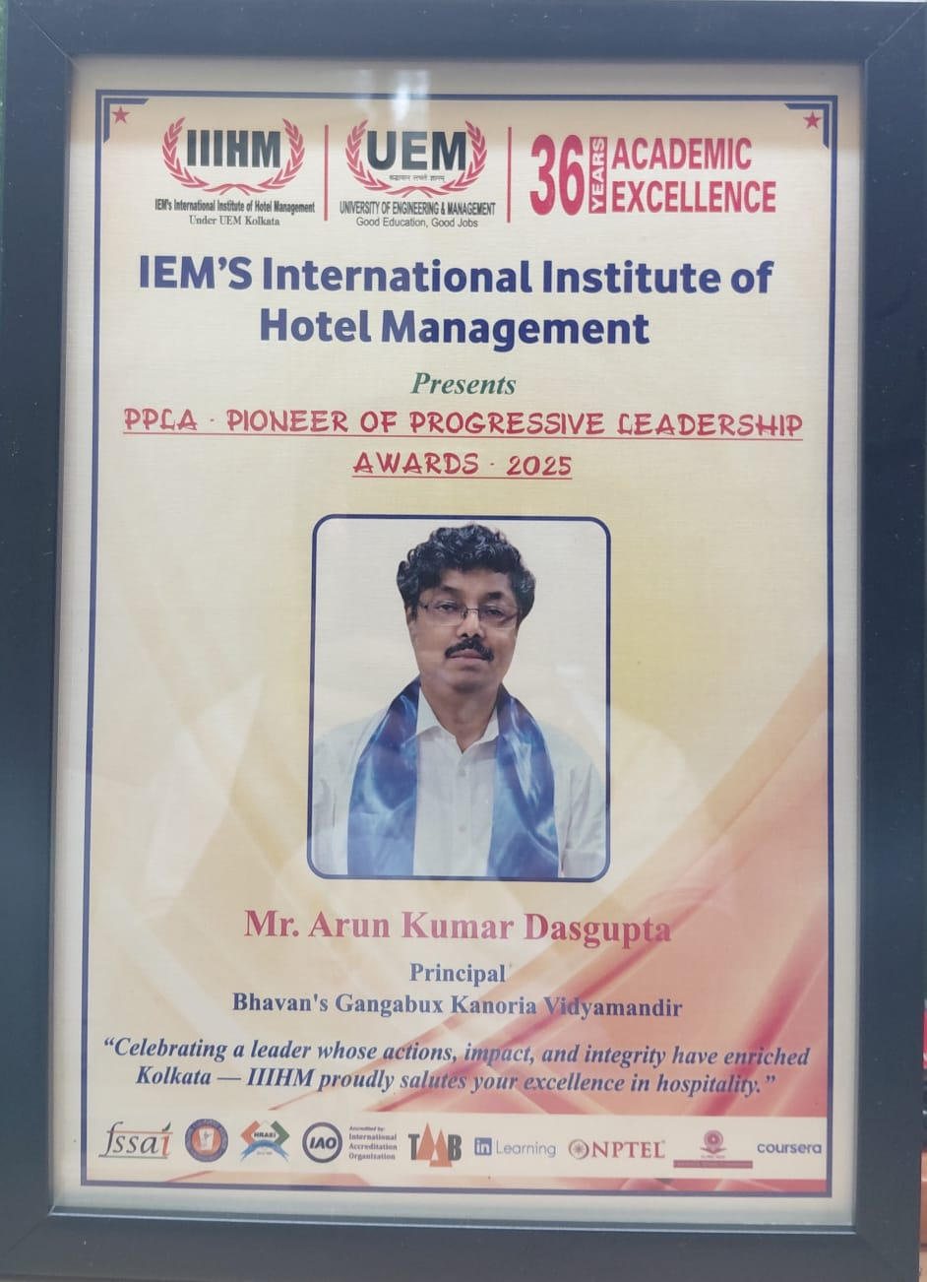
PIONEER OF PROGRESSIVE LEADERSHIP AWARDS
4th December 2025
THE PRINCIPAL WAS AWARDED WITH
PIONEER OF PROGRESSIVE LEADERSHIP AWARD 2025 FOR
“CELEBRATING A LEADER WHOSE ACTIONS,IMPACT, AND INTEGRITY HAVE ENRICHED KOLAKATA”
BY IEM’S INTERNATIONAL INSTITUTE OF HOTEL MANAGEMENT

Slide 37

EDUCATIONAL LEADERSHIP EXCELLENCE AWARD
6th December 2025
THE PRINCIPAL WILL BE AWARDED WITH EDUCATIONAL LEADERSHIP EXCELLENCE AWARD
BY EDUCATION EXCELLENCE CONCLAVE

Slide 38
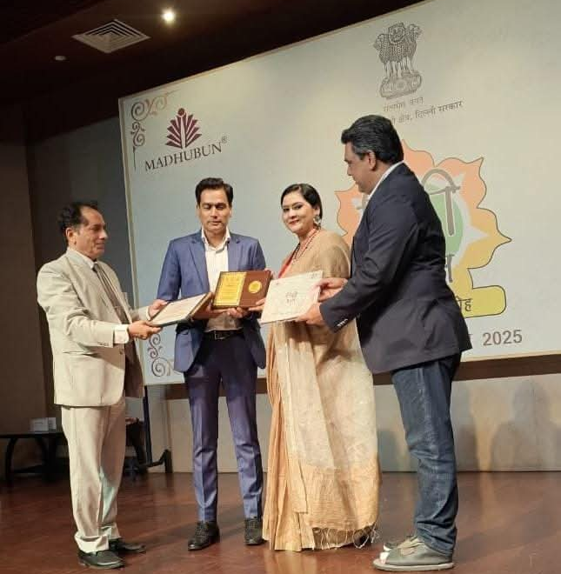
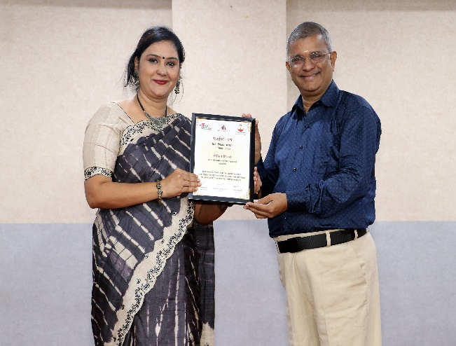
HINDI SHIKSHAK SAMMAN BY
MADHUBAN EDUCATION
25th September 2025
MRS. KAVITA TIWARI RECEIVED THE
HINDI “SHIKSHAK SAMMAN” FROM MADHUBAN EDUCATION UNDER THE AEGIS OF THE DELHI GOVERNMENT FOR HER DEDICATED SERVICE

Slide 39
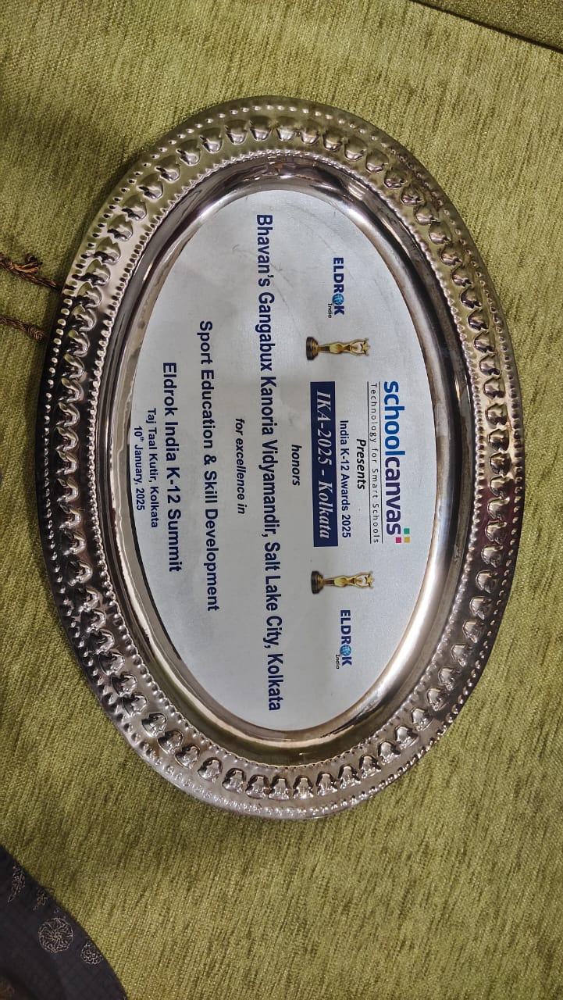
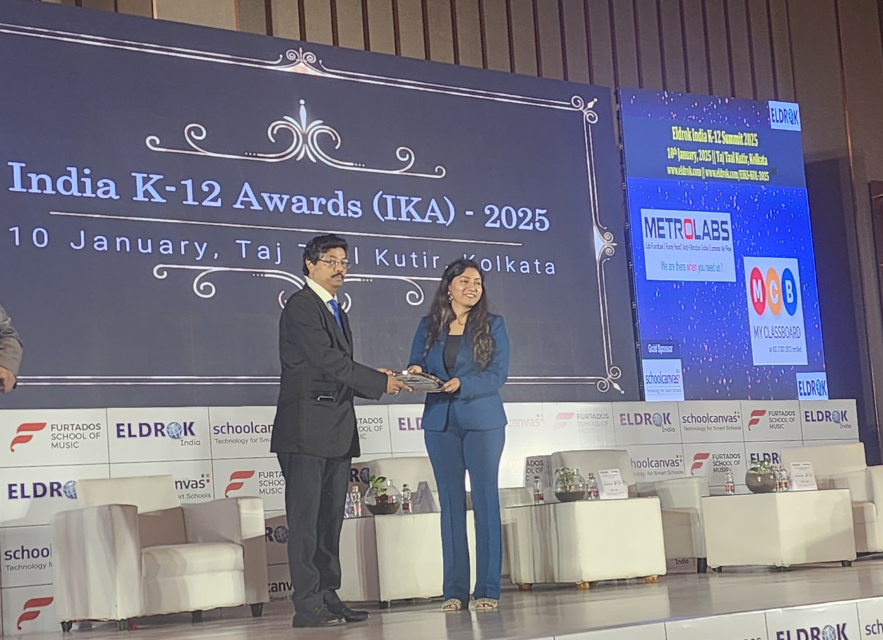
INDIA K-12 AWARD (IKA) -2025 BY SCHOOLCANVAS
10th January 2025
OUR SCHOOL WON THE AWARD FOR
“EXCELLENCE IN SPORTS EDUCATION AND SKILL DEVELOPMENT”.

Slide 40
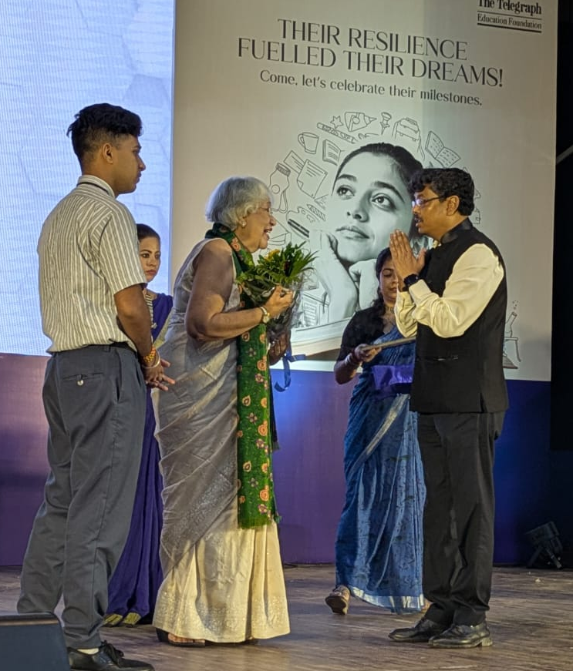
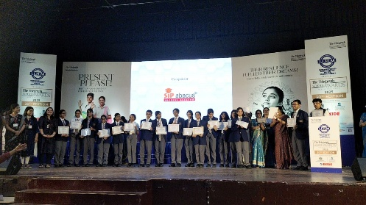
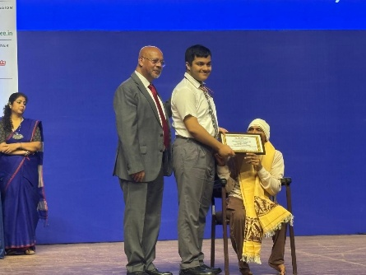
THE TELEGRAPH SCHOOL AWARDS FOR EXCELLENCE 2025
23rd August 2025 & 30th August 2025
THE PRINCIPAL OF BGKV PRESENTED THE LIFETIME ACHIEVEMENT AWARD TO SMT. SANGHAMITRA MUKHERJEE,
THE DIRECTOR OF GOKHALE MEMORIAL GIRLS’ SCHOOL.
THE SCHOOL CREATED HISTORY BY SECURING 25 AWARDS ACROSS DIVERSE CATEGORIES, INCLUDING
ACADEMICS, SPORTS, ART, MUSIC, DANCE, COURAGE, AND ALL-ROUND EXCELLENCE.

Slide 41
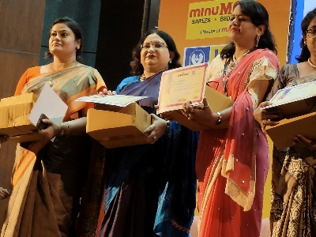
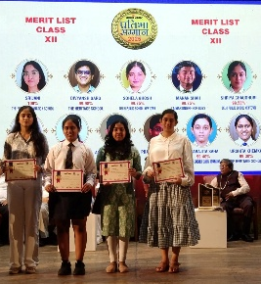
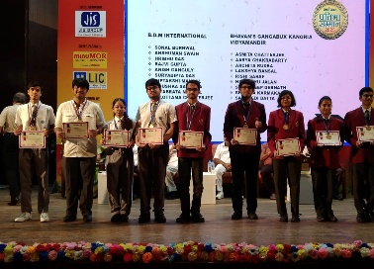
PRATIBHA SAMMAN AND GURU SAMMAN 2025 ORGANISED BY PRABHAT KHABOR
5th July 2025
MRS. DIPANWITA DUTTA, SENIOR FACULTY OF THE HINDI DEPARTMENT, WAS HONOURED FOR HER REMARKABLE CONTRIBUTION TO EDUCATION.
CLASS XII TOPPERS OF BGKV WERE FELICITATED WITH CERTIFICATES AND MEDALS FOR THEIR OUTSTANDING PERFORMANCE IN THE AISSE AND AISSCE EXAMINATIONS.

Slide 42

FELICITATION BY
PASCHIMBANGA RAJYA SARKARI KARMACHRI FEDERATION
13th June 2025
PATHIKRIT MAITRA, OUR AISSE TOPPER, BEING FELICITATED

Slide 43

FELICITATION BY TIMES EDU SHINE 2025
17th June 2025
PATHIKRIT MAITRA, SAANVI KUMAR, ARKO PAL, BIBHABARI KUNDU, APARAJITA SAHA, SHRISHA KARMAKAR AND SANGBEDI DATTA ,TOPPERS OF CLASS 10 AND 12 IN CBSE EXAMINATION 2025, WERE FELICITATED BY
TIMES EDUSHINE 2025
OUR SENIOR FACULTY MEMBER, MS. MAITREYI DE SARKAR RECEIVED THE AWARD ON BEHALF OF THE SCHOOL.

Slide 44


FELICITATION BY NARULA INSTITUTE OF TECHNOLOGY
20th May 2025
BIBHABARI KUNDU, AISSE THIRD RANK HOLDER OF OUR SCHOOL, WAS FELICITATED BY NARULA INSTITUTE OF TECHNOLOGY

Slide 45


FELICITATION BY JIS EDUCATION EXPO 2025
18th June 2025
JIS GROUP FELICITATED A HOST OF OUR SCHOOL TOPPERS OF CLASS 10 AND 12 IN CBSE EXAMINATION 2025.

Slide 46


MEDHA SAMMAN 2025 ORGANISED BY TAAZA TV
21st June 2025
CLASS XII ACHIEVERS FROM SCIENCE, COMMERCE, AND HUMANITIES WERE FELICITATED FOR THEIR OUTSTANDING PERFORMANCE IN THE AISSCE EXAMINATIONS 2025.

Slide 47


YOUNG SCHOLAR AWARD -2025 ORGANISED BY AMANTRAN TV NETWORK
24th June 2025
THE EVENT CELEBRATED ACADEMIC EXCELLENCE AND RECOGNIZED THE REMARKABLE ACHIEVEMENTS OF THREE OF OUR TALENTED STUDENTS — SAANVI KUMAR, ARKO PAL AND BIBHABARI KUNDU.

Slide 48

SPORTS AND GAMES

Slide 49



AARUSHI NANDI
Secured the third position in under – 15 , third position in Youth Girls Doubles and received 2 certificates at 86th Cadet and Sub Junior National.
Participated in the South Asian Youth TABLE TENNIS Championship 2025 (U- 15 Girls) and won a gold medal in U- 15 Girls Team, a gold medal in U- 15 Doubles and silver medal in U- 15 Singles.
Was ranked First in the Nabin Sangha Table Tennis Championship – 2025, a State Ranking Stage - I Tournament (U - 19/Girls), organised by Nabin Sangha Club.
Secured the First position at the Calcutta Table Tennis Championship 2025. (A State Ranking stage- II Tournament) (U - 17/ Girls - Singles).
ANUSHKA ROY
Received Gold Medals at the State Championship level and has been selected for the National.
Won Bronze medal (Secured 3rd position) among 5 countries of South Asia ( India, Pakistan, Nepal, Bhutan & Sri Lanka) and 14 participants of those 5 countries in Sub junior U-14, -45 Kg weight category, at Colombo SAKF ( South Asian Youth Karate Cup ) 2025.
Came Third in 69th West Bengal State School Games.

Slide 50


SAANVI MAITI
Secured First position in 50 Metres Back Stroke.
Secured Second position in 100 metres in Free Style.
Secured Third position in 100 metres in Apex- Pulse of Triumph, 2024 organised by Asian International School.
Received three medals at the CBSE Far East Zone Swimming Competition and has qualified for the CBSE National level.
Won Gold Medal in 200m Backstroke, Silver Medal in 400m Freestyle and Silver Medal in 800m Freestyle.
Has clinched the Gold Medal at the CBSE Athletic Meet Cluster II – 2025.
SUNISHKA DUTTA
Has been selected for the School Games Federation of India (SGFI).
At 68th National School Games in ARTISTIC GYMNASTICS for U- 14 GIRLS secured the First Position in Artistic Beam and Third Position in Floor Exercise.
Received a Bronze medal and three certificates.

Slide 51




VENKATESH DAS
Has become ‘ARENA INTERNATIONAL MASTER’ (AIM) honored by FIDE, Switzerland.
Secured 30th rank ( main group) in the '1st Pro Skillcraft International Classical Open FIDE Rated Chess Tournament‘.
Secured the 2nd position in the Inter school Chess Tournament 2025 held at The Scottish Church Collegiate School.
DEBAYAN RAY
Has emerged CHAMPION in the 5th CPPA Open International FIDE Rated Chess Tournament at Dibrugarh District, Assam.
Also became the STATE CHAMPION in the West Bengal State Rapid & Blitz Chess Championship 2025 (RAPID) organised by SBDS, KOLKATA.
NEELABHRO BANDYOPADHYAY
Secured the 10th Position and got cash Prize of Rs 7000/- and one certificate in First Royal Rivals International Open Fide Rated Chess Tournament -2024.
TANISH DAS
Won the Silver Medal at the SGFI State Chess Tournament 2025. His hard work, focus, and determination truly shine through this achievement.

Slide 52



AVIGYAN CHAKRABARTI
Showed remarkable prowess in Karate, representing the Wadokai style in the Under 30 Kg, below 13 Boys category. Currently holding a Brown Belt,
Participated in various prestigious tournaments during the academic year 2024–25 and secured commendable positions.
N24 pargana District WADOKAI Karate Championship
Kata -> Gold Kumite -> Bronze
All West Bengal WADOKAI karate Championship
Kata : Silver Kumite : Bronze
All India WADOKAI karate Championship
Kata : Gold Kumite : Bronze
SHARIQA SHAHID
Champion in the U-17 Girls Team, at the CBSE Far East Zone Table Tennis Competition.
JULINKA ROY CHOWDHURY
Champion of IGU (Indian Golf Union) East Zone in under – 13 girls’ category, she got the Top rank, based on the all IGU East Zone Tour Tournaments throughout 2024.
Also at the leader position in the IGU East Zone ranking so far up to October’25.

Slide 53

EVENTS IN SPORTS

Slide 54





ANNUAL SPORTS MEET 2024
20th December 2024
SMT. JYOTIRMOYEE SIKDAR, RENOWNED INDIAN ATHLETE AND PADMA SHRI AWARDEE, AND
SHRI. SOMNATH DUTTA, DISTRICT PHYSICAL EDUCATION OFFICER, YOUTH WELFARE, NORTH 24 PARGANAS
GRACED THE EVENT WITH THEIR PRESENCE.

Slide 55




THE BIDHANNAGAR SUBDIVISION SCHOOL GAMES & SPORTS COUNCIL
7th February 2025
NAME OF THE STUDENTS | EVENTS | POSITIONS
MRITSA SAHA BHOWMIK | 100M RACE LONG JUMP | THIRD SECOND
SAANVI MAITI | 3000M RACE 1500M RACE 800M RACE | FIRST SECOND THIRD
ARISHA SADIQUE KHAN | 100M RACE | SECOND
SARTHAK BANERJEE | 400M RACE 800M RACE | SECOND THIRD

Slide 56



INTERNATIONAL DAY OF YOGA
21st June 2025
STUDENTS, PARENTS AND TEACHERS ACTIVELY TOOK PART AND ENGAGED THEMSELVES IN DOING VARIOUS YOGA POSES FOR THE OVERALL HEALTH.

Slide 57



CBSE FAR EAST ZONE CHESS COMPETITION
1st -3rd August 2025
TANISH DAS, NEELABHRO BANDYOPADHYAY, VENKATESH DAS, AND DEBAYAN RAY AS
UNBEATEN CHAMPIONS AT THE CBSE FAR EAST ZONE CHESS COMPETITION.

Slide 58


CBSE FAR EAST ZONE
TABLE TENNIS COMPETITION
1st -5th August 2025
AARUSHI NANDI AND PRAGYANSHA PATRA, EMERGED AS CHAMPIONS IN THE
TEAM EVENT.
AARUSHI NANDI (U-17) AND SHARIQA SHAHID (U-14) HAVE ALSO CLINCHED INDIVIDUAL TITLES, WINNING IN THEIR RESPECTIVE CATEGORIES.

Slide 59


MIXED UNDER 17
NATIONAL CHESS CHAMPIONSHIP 2025
5th September 2025
TANISH DAS, NEELABHRO BANDYOPADHYAY, VENKATESH DAS AND DEBAYAN RAY EMERGED AS THE NATIONAL CHAMPION
IN THE MIXED UNDER 17 NATIONAL CHESS CHAMPIONSHIP 2025 HELD AT MDS PUBLIC SCHOOL, UDAIPUR.

Slide 60


CBSE 69TH NATIONAL SCHOOL GAMES (CHESS UNDER 17) AGARTALA, TRIPURA
27th November 2025
BGKV BOYS CHESS TEAM CREATED HISTORY!
TREMENDOUS ACCOMPLISHMENT BY BECOMING THE UNBEATEN CHAMPION IN THE SGFI
MEMBERS:
TANISH DAS, NEELABHRO BANDYOPADHYAY, VENKATESH DAS AND DEBAYAN RAY

Slide 61

ACTIVITIES
&
ENDEAVORS

Slide 62






13th NATIONAL INTEGRATION CAMP
25th April 2025-1st May 2025
SCIENCE FAIR 2025,ORGANISED BY
PASCHIM BANGA VIGYAN MANCHA
12th July 2025
A TEAM OF SIX STUDENTS FROM BGKV PROUDLY REPRESENTED THE SCHOOL AT THE 13TH NATIONAL INTEGRATION CAMP, HOSTED BY BHAVAN'S SRI RAMAKRISHNA VIDYALAYA, SAINIKPURI, HYDERABAD
OUR STUDENTS ENTHUSIASTICALLY PARTICIPATED IN THE ENGAGING SESSION “HATE KALOME BIGYAN” CONDUCTED BY TARUN MUKHERJEE AND HIS TEAM, AS WELL AS AN INSIGHTFUL ASTRONOMY SESSION BY DR. DEBI PRASAD DUARI.

Slide 63




INAUGURATION OF INTERACT CLUB
18th July 2025
ECO & INTERACT CLUB ACTIVITY
25th September 2025
AN EFFORT BY THE ECO CLUB AND INTERACT CLUB OF OUR SCHOOL TO PROMOTE ENVIRONMENTAL AWARENESS BY PLACING QR CODES ON TREES ACROSS THE CAMPUS
GREEN PLEDGE BEING TAKEN BY ALL STUDENTS,
RE-AFFIRMING THEIR COMMITMENT TO SUSTAINABILITY AND ECO-FRIENDLY PRACTICES

Slide 64



VIGILANCE AWARENESS WEEK
30th October 2025
VISIT OF DR. ARCHANA MAJUMDER
4th November 2025
STUDENTS AND TEACHERS ENTHUSIASTICALLY PARTICIPATED AND CONDUCTED VARIOUS ACTIVITIES HIGHLIGHTING THE THEME 'VIGILANCE-OUR SHARED RESPONSIBILITY'.
HONOURABLE MEMBER OF THE NATIONAL COUNCIL FOR WOMEN, DR. MAJUMDER SPOKE EXTENSIVELY ABOUT CHILD SAFETY, WOMEN’S HEALTHCARE, AND STUDENT WELLNESS

Slide 65


PARENTS’ COUNSELLING SESSION FOR CLASSES 9 & 11
8th March 2025
PARENTS WERE PROVIDED WITH COMPREHENSIVE BRIEFINGS ON VARIOUS ASPECTS, INCLUDING ATTENDANCE,
EXAMINATION PATTERNS AND OTHERS.
THE SCHOOL COUNSELLOR, MRS. SHOVONA MUKHERJI CONTINUED THE SESSIONS, DISCUSSING THE TRUE ESSENCE OF COUNSELLING, EMPHASISING THE IMPORTANCE OF MAINTAINING A HEALTHY TIME SCHEDULE, ADEQUATE SLEEP,
PARENTAL BEHAVIOUR AND
MANAGING PARENTAL EXPECTATIONS.
A NOBLE INITATIVE BY THE SCHOOL:
ACTIVE PARTICIPATION OF OUR PARENTS

Slide 66

PARENTS’ ORIENTATION SESSION FOR CLASSES 6 & 11
30th June- 9th July 2025
BGKV ORGANISED A SERIES OF ORIENTATION PROGRAMMES FOR THE PARENTS.
THE MAJOR OBJECTIVE OF THE PROGRAMME WAS TO MAKE THE PARENTS AWARE OF THE
ACADEMIC ASPECTS OF THE SCHOOL,
THE RULES AND REGULATIONS OF THE INSTITUTION AND OTHER VITAL ASPECTS

Slide 67


ORIENTATION SESSION FOR TWO-BOARD EXAMINATION
24th & 25th July 2025
AN EFFORT TO HELP THE PARENTS AND STUDENTS OF CLASS 10
ORIENTATION SESSION FOR THE PARENTS OF CLASS 10 TO HELP THEM CLARIFY THEIR DOUBTS AND QUERIES PERTAINING TO THIS NEW SYSTEM. A SESSION SIMILAR TO THIS WAS ALSO CONDUCTED FOR THE STUDENTS ON 25TH JULY 2025 ENSURING THAT OUR STUDENTS ARE THOROUGHLY ACQUAINTED WITH THE NEW EXAMINATION SYSTEM.

Slide 68





NATIONAL CYBER SECURITY AWARENESS MONTH
28th - 31st October 2025
CYBER JAGRIT BHARAT TO ENHANCE CYBER SECURITY AWARENESS AMONG STUDENTS AND TEACHERS WHICH FOCUSED ON REAL LIFE SKILLS TO COMBAT ONLINE THREATS

Slide 69

OBSERVANCE OF SPECIAL DAYS

Slide 70





WORLD HINDI DAY
10th January 2025
162nd BIRTH ANNIVERSARY OF SWAMI VIVEKANANDA
12th January 2025
OUR STUDENTS PAYING TRIBUTE TO
OUR NATIONAL LANGUAGE
CELEBRATING THE PRINCIPLES OF VIVEKANANDA

Slide 71



PARAKRAM DIWAS
23rd January 2025
REPUBLIC DAY
26th January 2025
OUR STUDENTS CELEBRATING PARAKRAM DIWAS
CELEBRATING THE 76TH REPUBLIC DAY WITH GREAT ENTHUSIASM AND FERVOUR

Slide 72


164th BIRTH ANNIVERSARY OF
GURUDEV RABINDRANATH TAGORE
9th May 2025
REMEMBERING THE FIRST INDIAN NOBEL LAUREATE

Slide 73





HAR GHAR TIRANGA
2nd -15th August 2025
AS A PART OF THE GOVERNMENT OF INDIA’S HAR GHAR TIRANGA INITIATIVE, STUDENTS OF BGKV PARTICIPATED ENTHUSIASTICALLY IN A SERIES OF ACTIVITIES .

Slide 74





INDEPENDENCE DAY
15th August 2025
CELEBRATION OF THE 79TH INDEPENDENCE DAY WITH FERVOUR AND PRIDE WITH A VIBRANT PRABHAT PHERI WHICH WAS FOLLOWED BY THE HOISTING OF THE NATIONAL FLAG AT THE SCHOOL CAMPUS AND A CULTURAL PROGRAMME.

Slide 75




TEACHERS’ DAY CELEBRATION 2025
17th September 2025
MRS. SARMISTHA SEN AND MRS. MOUSUMI MUKHERJEE BEING FELICITATED FOR COMPLETING 20 GLORIOUS YEARS IN THE INSTITUTION AS A MENTOR.
OUR STUDENTS CELEBRATED TEACHERS’ DAY WITH GREAT ENTHUSIASM AND REVERENCE SHOWING THEIR LOVE AND PAYING RESPECT TO THE GUIDING LIGHTS WHO SHAPE COUNTLESS YOUNG MINDS.

Slide 76




SWACHHATA PAKHWADA 2025
17th-30th September 2025
SWACHHATA PAKHWADA BEING OBSERVED IN OUR SCHOOL WITH FOCUSED PARTICIPATION RESULTING IN CLEANLINESS, SANITATION AND A HYGIENE DRIVE TOGETHER WITH A SERIES OF RELATED ACTIVITIES

Slide 77



CONSTITUTION DAY CELEBRATION 2025
26th November 2025
THE PREAMBLE WAS READ OUT AND PLEDGE WAS TAKEN IN THE SCHOOL ASSEMBLY
POSTERS AND COLLAGES WERE MADE TO COMMEMORATE THIS SPECIAL DAY

Slide 78

TRAININGS
&
WORKSHOPS

Slide 79

SERIAL NUMBER | DATE | NAME OF THE WORKSHOP | TEACHERS ATTENDED
1. | 16th January – 17th January 2025 | Adolescence education | Soma Goswami, Rupsa Biswas
2. | 14th May 2025 | Educating Parents about Education | Aparna Das and Riya Mondal
3. | 14th June 2025 | Capacity Building Programme (CBP) on "Promoting Mental Health and Wellness among Students" | Mrs. Mita Bera
4. | 26th June 2025 | Online webinar - “3030 Eklavya STEM Education” | Ruby Das, Sohini Deb, and Trisha Choudhury
5. | 26th June 2025 | Capacity Building Program on Environmental Education and Conservation of Natural Resources | Sohini Chakraborty, Poulami Ghosh, Somadutta Mukherjee, Pranjali Shome and Shazia Afreen
6. | 11th July - 12th July 2025 | Capacity Building Programme - “Joyful Mathematics” | Mrs. Aparna Das and Mr. Hari Shankar Nandi
7. | 17th July 2025 | Workshop conducted by WBSAP&CS | Moumita Mukhopadhyay and Ipshita Kundu
8. | 23rd July – 24th July 2025 | Senior Secondary Physics | Paramita Chatterjee, Rudrani Chakraborty
9. | 26th July 2025 | Use of AI in Classrooms | Anumita Chakraborty, Trisha Choudhury, Aritra Roy, Md. Ali Mullick, Riya Mondal, Sohini Deb, Nilanjana Mitra, Cynthia Simontini Benjamin, Ipsita Halder, Sampa Sen
10. | 28th July 2025 | STEM | Pranjali Shome, Gargy Ghoshal

Slide 80
SERIAL NUMBER | DATE | NAME OF THE WORKSHOP | TEACHERS ATTENDED
11. | 6th August 2025 | Online Orientation Session on SWAYAM MOOCs. | Computer Department (Secondary Wing)
12. | 22nd August – 25th August 2025 | Teachers as a Design Scientist | Debayan Kundu, Nirmal Mondal, Sujay Acharya, Ipshita Kundu, Piu Ghosh
13. | 30th August 2025 | Capacity Building Programme | Sriparna Mitra (Resource person)
14. | 10th October - 11th October 2025 | Capacity Building Programme (CBP) on Mathematics | Sujoy Acharjee and Tithi Roy
15. | 25th October 2025 | Stress Management | Payel Mallick and Fedel francis Osta
16. | 30th October -31st October 2025 | Economics (Senior Secondary) | Ipsita Halder
17. | 30th October - 31st October 2025 | Adolescent Education Programme | Somadutta Mukherjee and Subhechha Banerjee
18. | 15th November 2025 | Workshop conducted by Burlington – Be Inspired – How the Brain Loved Rhythm | Nilanjana Mitra and Sejuti Biswas
19. | 19th November 2025 | Psychological First Aid – A multidimensional Framework for Promoting Mental wellbeing in Educational Settings’ | Shovona Mukherjee, Sampita Chakraborti and Mita Bera
20. | 22nd November 2025 | Happy Classrooms | Barnali Dwari and Satarupa Saha

Slide 81



Thank You

